Slide 1

A VISITOR PILOT FOR THE PARK BOARD OF TRUSTEES
The Galveston HOT Route
Open-air carts that carry hotel guests and visitors around downtown, from the cruise terminals to their hotels.
I'm here to ask for a pilot.
Raymond Arce | Raymond4Galveston@gmail.com
Plan Version 2.0 | October 14, 2026
© 2026 Raymond Arce · Concept first published September 3, 2025 · Plan Version 2.0, October 14, 2026

Slide 2
THE RESEARCH · THE LAW
The law already allows this.
Texas Tax Code Chapter 351 sets how hotel tax is spent.
A use the law names
Section 351.110(a) allows hotel tax for "a transportation system to move tourists from hotels in and near the municipality to" the commercial center, a convention center, other hotels and tourist attractions.
Built for visitors
Section 351.110(c) bars a system for the general public unless it is "primarily used by tourists." Free rides for hotel guests and rider counts show it.
Spent for tourism
Section 351.101(b) says every dollar must directly promote tourism and the hotel industry. Rider counts and the hotel guest share are the record.
© 2026 Raymond Arce · Concept first published September 3, 2025 · Plan Version 2.0, October 14, 2026

Slide 3
THE RESEARCH · THE MONEY
Council holds the money and sets the duties.
3 duties
$21 million
4 weeks
In the Park Board hotel tax contract today: advertising, lifeguards, beaches
The most the Park Board can receive in FY2027
Notice the City needs before Council takes up a budget change
Council approves the Park Board budget. Hotel tax collected beyond the Board’s award stays with the City, and Section 351.110 lets the City spend it on tourist transportation.
Sources: FY2027 hotel tax contract between the City and the Park Board (Council agenda, Sept. 17, 2026), Sections V, VII and XVIII and Exhibit A. City Charter, Art. VIII, Sec. 2(a). Tax Code 351.110.
© 2026 Raymond Arce · Concept first published September 3, 2025 · Plan Version 2.0, October 14, 2026

Slide 4
THE RESEARCH · THE PATH
The Board asks. Council funds.
Three steps, each one already in the rules.
1
2
3
The Board asks
Council funds it
The Board hires
A Board vote asking Council to add tourist transportation to its hotel tax duties.
Council amends the contract and budget, paying from hotel tax beyond the Board’s award.
A request for proposals, scored on best value, then a contract under Local Gov’t Code 306.038.
© 2026 Raymond Arce · Concept first published September 3, 2025 · Plan Version 2.0, October 14, 2026

Slide 5
THE RESEARCH · THE OPERATOR
The operator is picked in the open.
How the Park Board hires the company that runs the carts.
Competitive proposals
Contracts over $100,000 go out for bids or proposals (Local Gov’t Code 252.021). The pilot is $336,960 a year.
Best value, not lowest price
Park Board requests for proposals are scored on best value, under Chapter 252 and the Board’s purchasing policy.
Trustees approve
Any payment over $15,000 to one vendor needs trustee approval (hotel tax contract, Section XVI).
Disclosures on file
The operator files Ethics Commission Form 1295, and a conflict of interest form if it has ties to a trustee (Gov’t Code 2252.908; Local Gov’t Code 176).
© 2026 Raymond Arce · Concept first published September 3, 2025 · Plan Version 2.0, October 14, 2026

Slide 6
WHO IS ALREADY HERE
They're already here. Let's show them around.
9.1 million
1.84 million
60 minutes
Visitors to the island in 2025
Cruise visitors who board or leave ship here
Trolley wait before noon and after 6 p.m.
In our heat, few people walk far. Most park on one block and stay there. Downtown merchants say cruise guests are not reaching their doors.
Visitors: Tourism Economics for the Park Board, 2025 report, May 2026. Trolley: City of Galveston Island Transit, fall 2026. Merchants: The Daily News, Aug. 11, 2026.
© 2026 Raymond Arce · Concept first published September 3, 2025 · Plan Version 2.0, October 14, 2026

Slide 7
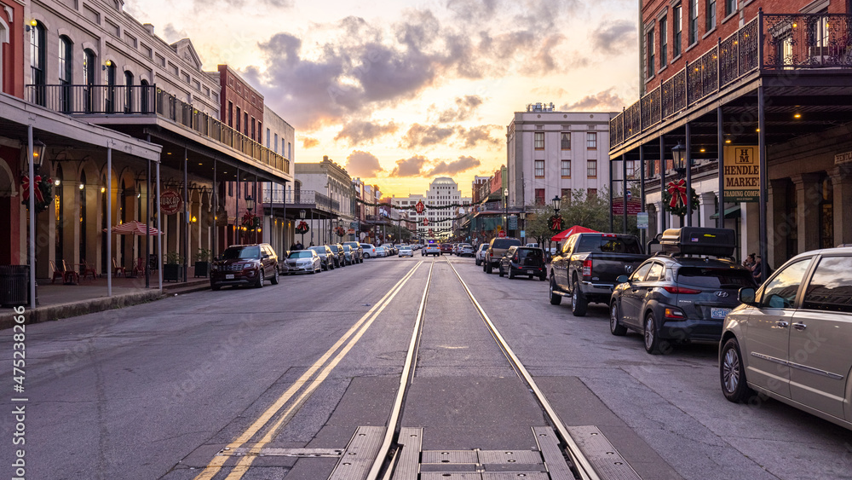
EVERY BLOCK HAS SOMETHING TO SEE
If we want to supercharge foot traffic, this is the way to do it.
A short ride puts 95 hotels, bars, restaurants, coffee shops, galleries and clothiers within easy reach.
© 2026 Raymond Arce · Concept first published September 3, 2025 · Plan Version 2.0, October 14, 2026

Slide 8
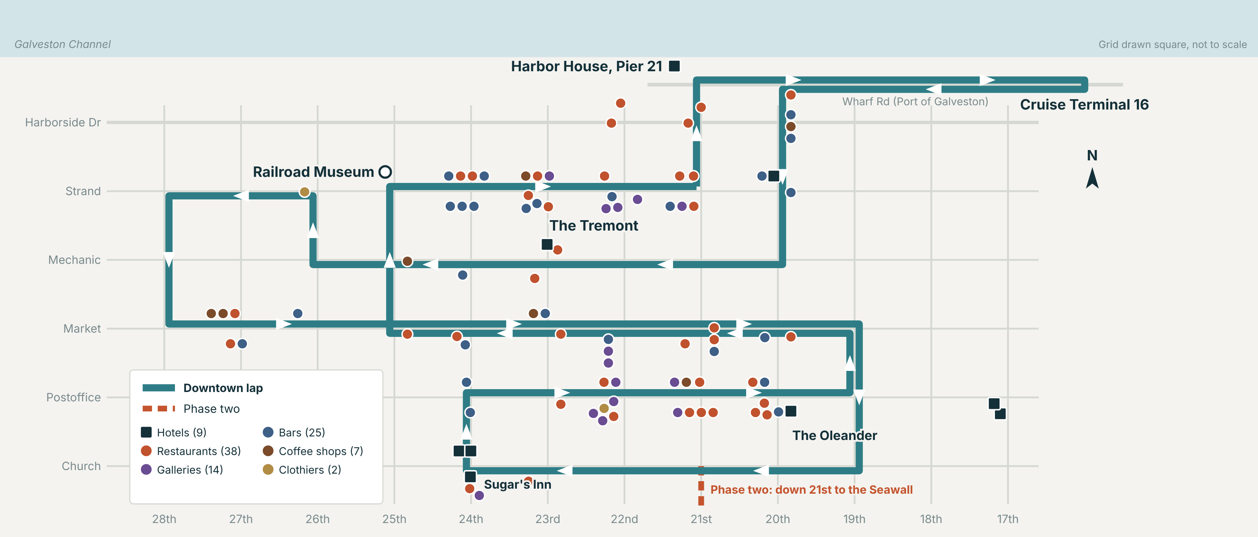
THE ROUTE
One lap, from the port to Church Street.
© 2026 Raymond Arce · Concept first published September 3, 2025 · Plan Version 2.0, October 14, 2026

Slide 9
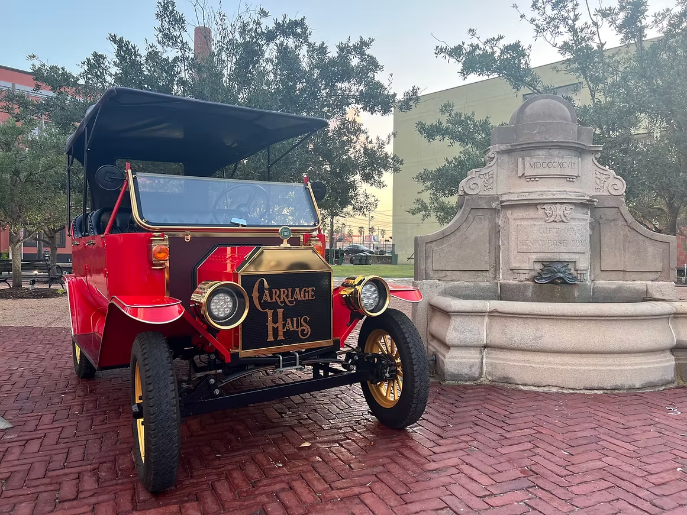
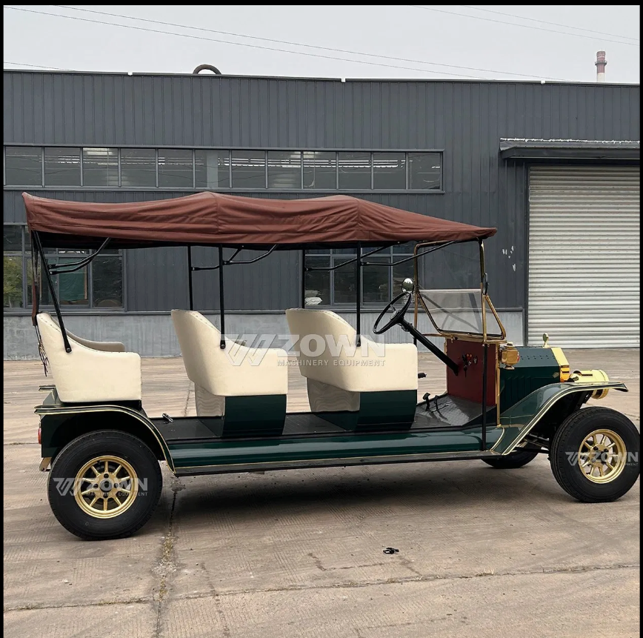
THE CARTS
Already on our streets.
Seven riders and a driver, open to the breeze
Sized for downtown blocks and brick streets
Photographs courtesy of Carriage Haus Rentals, Galveston, used with permission.
© 2026 Raymond Arce · Concept first published September 3, 2025 · Plan Version 2.0, October 14, 2026

Slide 10
HOW IT WORKS
Wave. It stops. Hop on.
Easier than a trolley, and a lot more fun.
A wristband, not a ticket
Free with the room at participating hotels. Everyone else buys a $10 day band downtown or by QR code.
Flag it from the curb
Hold up the band. The next cart pulls over at the curb, never in a travel lane, a crosswalk or on trolley track.
On and off all day
Shop a block, ride two, stop for lunch. The whole route is the stop.
Open air the whole way
A ride people remember, and photograph.
© 2026 Raymond Arce · Concept first published September 3, 2025 · Plan Version 2.0, October 14, 2026

Slide 11
THE APP
See the carts coming.
A live map
Step out when it's close
Every cart on a live map, like a ride share app, with the businesses on the route marked.
Riders see a cart coming, walk to the curb and flag it down.
Scan the wristband
A record for the Board
A QR code on every band opens the live map in a browser and links to the app.
Cart locations and wristband scans show who rides, where and when, and how many are hotel guests.
© 2026 Raymond Arce · Concept first published September 3, 2025 · Plan Version 2.0, October 14, 2026

Slide 12
A GUEST'S DAY
Park once. Enjoy the day.
Leave the car and take in the town.
1
2
3
Park once
Ride all day
Find something to do
Leave the car at the hotel or a downtown garage for the day.
One downtown lap. Wave the wristband and the next cart stops.
Certified Tourism Ambassador operators know what’s happening on your block: eat, drink, shop, play.
© 2026 Raymond Arce · Concept first published September 3, 2025 · Plan Version 2.0, October 14, 2026

Slide 13
WHAT IT DOES FOR THE ISLAND
Everyone on the route wins.
FOR HOTELS AND SHOPS
FOR THE PARK BOARD
More visitors at the door
Hotel tax put to work
Guests see downtown without moving the car
Links the attractions the Board already promotes
Cruise guests and crews arrive with hours to spend
Free to the guests who pay the tax
Hotels give the wristband with the room
No carts for the Board to buy
Every shop on the route becomes a stop
© 2026 Raymond Arce · Concept first published September 3, 2025 · Plan Version 2.0, October 14, 2026

Slide 14
WHO RUNS IT
A local operator, chosen in the open.
The operator brings the carts. The Park Board pays for the service.
WHAT THE OPERATOR PROVIDES
WHAT THE PARK BOARD KEEPS
Carts, a home base and drivers
Control, through the contract
Four carts: three on the road, one accessible cart in reserve
Pays only for the hours the carts run
A facility to store, charge and dispatch the carts
Sets the measures and the reports
Trained drivers
Audits the books and can end the contract if measures are missed
The Park Board may contract under Local Government Code 306.038. Tax Code 351.101(d) requires full records of every hotel tax dollar the operator spends.
© 2026 Raymond Arce · Concept first published September 3, 2025 · Plan Version 2.0, October 14, 2026

Slide 15
HOW THE PILOT RUNS
Three days a week, measured by the hour.
Three days a week
Measured by the hour
Three carts run the downtown lap 12 hours a day, 156 days a year. A fourth waits in reserve.
Success is six or more riders per cart hour, and a rising share of hotel guests.
Riders left waiting earn the next cart
Phase two comes after
We add a cart when riders are being turned away at the curb.
Next, the Seawall route from Pier 21 down 21st to the Galvez and Stewart Beach.
© 2026 Raymond Arce · Concept first published September 3, 2025 · Plan Version 2.0, October 14, 2026

Slide 16
WHAT IT COSTS
One rate, priced in the open.
$60
$336,960
10.2%
Per cart hour, carts and facility included
A year, three carts, three days a week
Of one penny of hotel tax
 | Basis | Per year
Drivers | Two 6-hour shifts a cart, $20 an hour | $124,675
Facility | $7,000 a month: storage and charging | $84,000
Carts | Four at $20,000, five-year life | $16,000
Driver permits | 9 to 12 drivers at $25 each | $300
Everything else | Insurance, upkeep, training, administration, luggage check-in and checkout, margin | $111,985
Park Board contract | 5,616 cart hours at $60 | $336,960
What the rate covers: the carts, the facility, the drivers, administration, luggage check-in and checkout, insurance, upkeep and the live map. The Park Board buys no vehicles.
The reserve cart: a fourth cart, wheelchair accessible, covers breakdowns and riders who use wheelchairs.
Still to quote: insurance. It comes out of the operator's share, not a new line. No property tax, sales tax or general fund dollars.
Three years at today’s rate: about $1.01 million.
Three carts on the road and one in reserve, 12 hours a day in two six-hour shifts, three days a week, 156 days a year: 5,616 cart hours. Comparable city contracts run about $37 to $55 per vehicle hour, with the city buying the vehicles; this rate includes the carts and the facility. Drivers at $20 an hour, about $22.20 with payroll taxes. Carts at $20,000 each, owned by the operator, with a five-year life including batteries. One penny of hotel tax is about $3.3 million in the FY2027 Park Board budget. Fares from riders who are not hotel guests are not counted here.
© 2026 Raymond Arce · Concept first published September 3, 2025 · Plan Version 2.0, October 14, 2026

Slide 17
THE ASK
Three decisions for the Board.
And what we bring.
Ask for the duty
A Board vote asking Council to add tourist transportation to the Board’s hotel tax duties.
Ask for the money
$336,960 a year in hotel tax: $60 per cart hour, three carts, 12 hours a day, three days a week.
Seek proposals
A request for proposals for a local operator, with riders per cart hour reported every quarter.
What we bring
Signatures from the hotels and businesses on the route, and a program concept the Board can build its request on.
© 2026 Raymond Arce · Concept first published September 3, 2025 · Plan Version 2.0, October 14, 2026

Slide 18
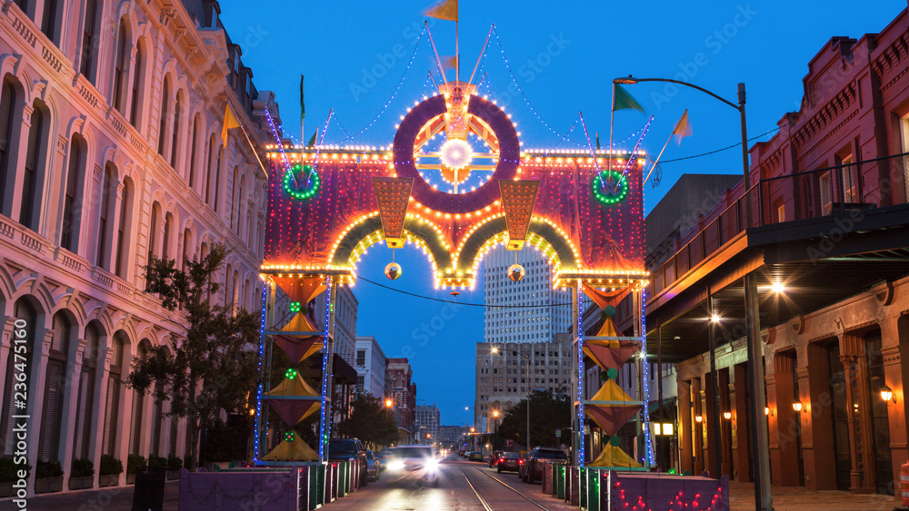
WE'VE SEEN IT WORK
On festival nights, the island shines.
People stroll, the blocks fill up, and no one hunts for parking. The HOT Route brings that feeling to three days of every week.
© 2026 Raymond Arce · Concept first published September 3, 2025 · Plan Version 2.0, October 14, 2026

Slide 19
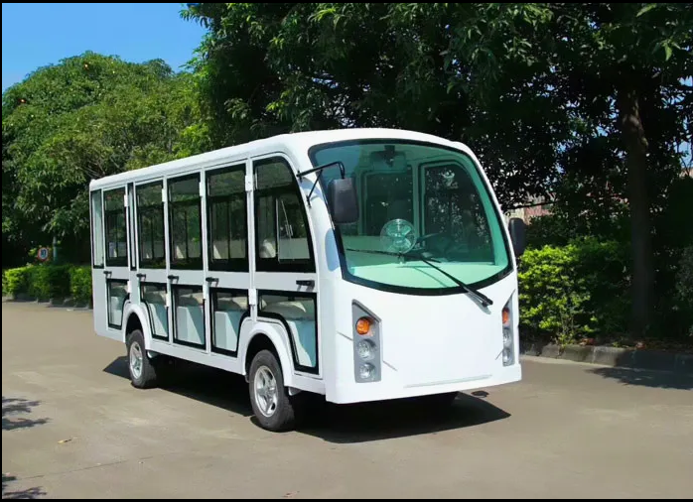
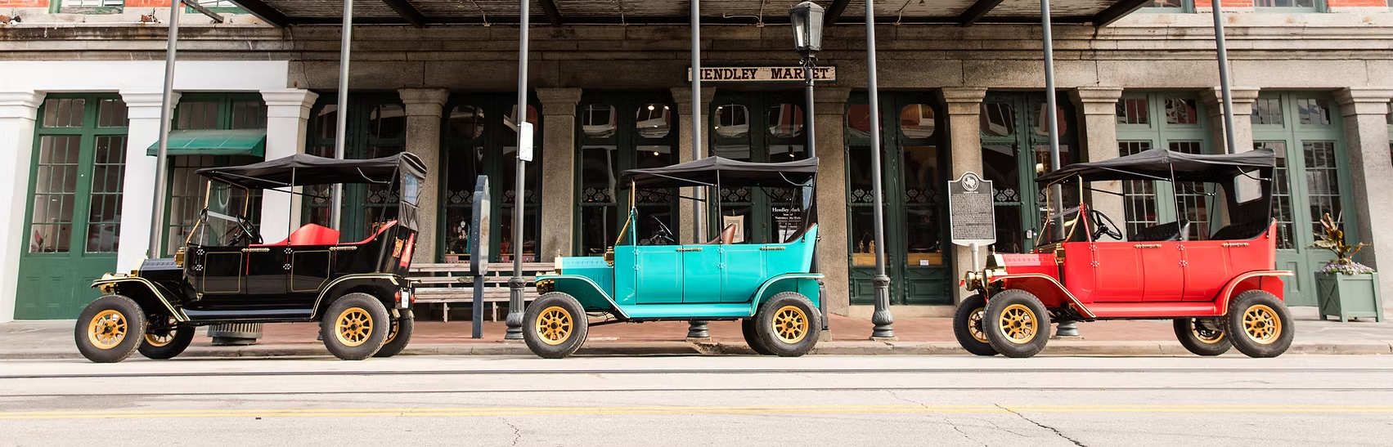
More than 9 million a year.
Let's welcome them downtown, with a ride they'll remember.
Raymond Arce | Raymond4Galveston@gmail.com
© 2026 Raymond Arce · Concept first published September 3, 2025 · Plan Version 2.0, October 14, 2026

