Slide 1
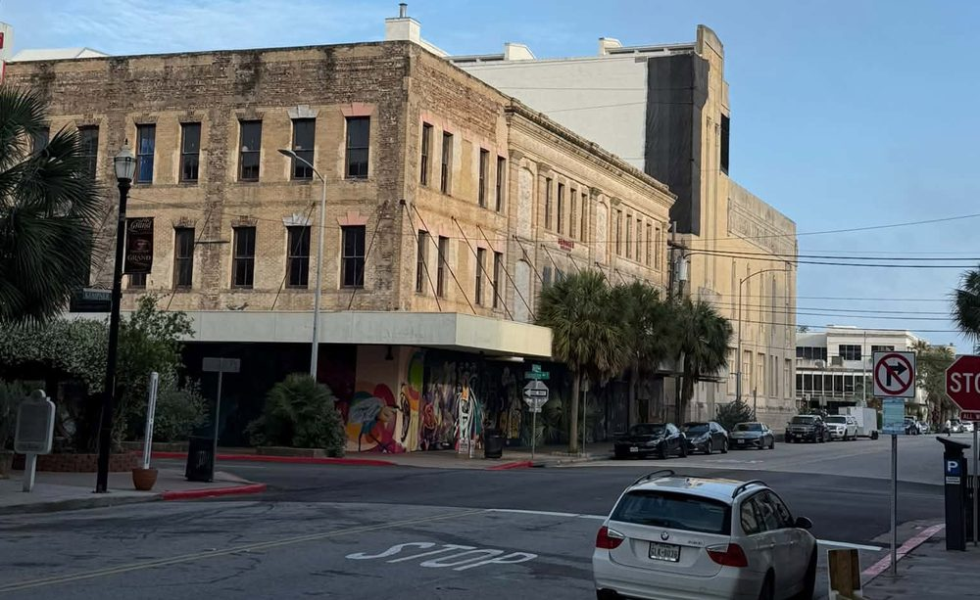
A PROPOSAL FOR DOWNTOWN
Own the Block
Downtown needs this for three reasons that weigh the same. Two thousand residents, cruise passengers and crews, and the students and staff at A&M Galveston and UTMB have nowhere to buy fresh food without a drive. A grocery brings people downtown on the slow days, which is what every shop around it needs. And it is a first investment for the young islanders we keep losing.
Four legs: the money, the tax breaks, the project, and the next generation
Raymond Arce | Candidate, Galveston City Council District 3 | Raymond4Galveston@gmail.com
© 2026 Raymond Arce · Concept first published September 25, 2026

Slide 2
WHY A GROCERY STORE, AND NOT SOMETHING ELSE
Three reasons. They weigh the same.
The demand is real. The block around it needs the traffic. And the people who should own it are the ones this island keeps losing.
Access to food
An anchor
The next generation
Fresh produce and daily essentials within walking distance for two thousand residents, the crews coming off the ships, and 1.8 million cruise passengers a year. Today the closest store is more than a mile away.
A grocery brings people downtown Sunday through Thursday, when the shops around it are empty. That foot traffic is what they live on. No other tenant does it seven days a week.
Galveston lost 775 families and nearly 900 public school students in a decade. A hundred dollar share, built with the colleges and taught with it, makes the young people we keep losing the owners of the block.
Ask a shop owner what Tuesday looks like. Ask a parent where their kids moved. One store answers both.
Cruise passengers, 20 percent of 9.1 million visitors in 2025, from Visit Galveston, Economic Impact of Visitors to Galveston Island, May 2026. Families and students from Vision Galveston, June 23, 2021, using American Community Survey data for 2010 to 2019 and 2012 to 2019. Downtown population is the 2024 Census figure reported by The Galveston County Daily News, August 11, 2026.
© 2026 Raymond Arce · Concept first published September 25, 2026

Slide 3
WHERE WE ALREADY ARE
The demand is not the question.
Three numbers, and none of them are in dispute.
About 2,000
1.2 miles
Millions
People living downtown, roughly a fifth of District 3
From downtown to the closest grocery, a small market on the east end. The supermarkets are three miles and more west
What it costs to rehabilitate one of these buildings, which is why they stay empty
So the question is not whether downtown needs a grocery store. It is who is allowed to pay for one.
Downtown population is a 2024 Census figure as reported by The Galveston County Daily News on August 11, 2026. District 3 had 9,225 people at the 2021 redistricting. Distances are straight line from 22nd and Market to Arlan's Market at 513 Market and to the Kroger at 5730 Seawall, so the drive is longer.
© 2026 Raymond Arce · Concept first published September 25, 2026

Slide 4
TWO CAMPUSES, ONE GAP
Between two campuses.
Thousands of students and hospital workers, and no supermarket near either one.
2,300
20,000
3+ miles
Texas A&M Galveston students, across the channel on Pelican Island
UTMB employees and students on the east end, next door to downtown
From either campus to the nearest supermarket. Near UTMB, only a small market
Downtown sits in the middle. A store here serves both campuses and everyone in between.
Enrollment from Texas A&M University at Galveston, nearly 2,300 students. Workforce of 16,567 and enrollment of 3,604 from the UTMB FY 2025 Data Reference Card. Distances are straight line from each campus to the Kroger at 5730 Seawall and the Randalls at 2931 Central City Blvd., 3.4 to 4.4 miles, so the drive is longer. The small market near UTMB is Arlan's at 513 Market.
© 2026 Raymond Arce · Concept first published September 25, 2026

Slide 5
WHAT IS BEHIND THE WALLS
The bill comes before the rent.
Asbestos, by law
Texas requires an asbestos survey before any renovation of a commercial building. In a building from the early 1900s the survey usually finds some, and removal is licensed, slow and expensive.
Lead paint
Anything painted before 1978 is presumed to have it. Stripping or sealing it is a trained crew, not a weekend.
Water, from 2008
Ike put downtown under water from Harborside to Market Street, and the city estimated three quarters of its buildings took flood damage. What dried behind plaster eighteen years ago is still there.
A century of settling
Termites, rusted iron, cracked brick and floors that are no longer level. None of it shows on a listing, and all of it shows up in the estimate.
Asbestos survey requirement at 25 Tex. Admin. Code 296.191(d)(1). Ike flooding and the 75 percent figure as recalled by The Galveston County Daily News, September 12, 2024. This is the reason a bank alone will not do these buildings, and the reason the tax stack and a foundation matter.
© 2026 Raymond Arce · Concept first published September 25, 2026

Slide 6
WHY IT NEVER PENCILS
The deal is the wrong size.
Too small for the big money
Funds that do this for a living want projects ten times this size, and they price the remediation first. One old building downtown is not worth their time.
Too big for any one of us
Nobody on this island is writing a check by themselves for a building that has been empty for decades.
The rules keep locals out
Most private real estate deals are open only to accredited investors, which generally means a million dollars in net worth. That is federal law, and it is why your neighbors have never been offered a piece of downtown.
So nothing happens
The building sits. Somebody eventually buys it cheap, and the money it makes leaves the island. We have watched this happen for thirty years.
Accredited investor is defined at 17 C.F.R. 230.501(a). The thresholds are a million dollars in net worth excluding your home, or two hundred thousand dollars of income, with other ways to qualify added in 2020.
© 2026 Raymond Arce · Concept first published September 25, 2026

Slide 7
THE IDEA
A fund the whole island can buy into.
It is called a diversified community investment fund. Twenty two communities are in a program to build one. The first opened in Rhode Island in 2024, and there is not one in Texas yet.
Anyone can invest
It owns buildings
It is not charity
Not just people with a million dollars. In Rhode Island the smallest share is five hundred dollars, and it is reserved for lower income residents.
At least sixty percent of the fund has to be real estate or other hard assets. The rest can go into the businesses that fill it.
The fund earns rent and profit and pays it out to the people who invested. The building pays property tax like any other.
We would not be inventing this. We would be the first city in Texas to use it.
The sixty percent rule and the structure come from the National Coalition for Community Capital. Rhode Island terms from the Local Return fund. The twenty two communities are a Kresge funded program run by NC3 with the International Economic Development Council, as described by Neighborhood Economics in May 2026. Any real offering needs securities counsel first.
© 2026 Raymond Arce · Concept first published September 25, 2026

Slide 8
WHAT WOULD MAKE IT REAL
An idea is like a table.
1. The money
Neighbors buying small shares, the investors who already do this buying larger ones, a foundation matching the first dollars in, and a loan on top. Four sources, one fund.
2. The tax breaks
Four of them, and downtown is about to qualify for the biggest one. Stack them and the private money only has to cover what is left.
3. The project
One building, a builder who has done this before, a grocer who wants the space, and a local nonprofit holding the fund.
4. The next generation
Galveston College at the table from the start, a hundred dollar share for students and young islanders, and the financial training that comes with owning something.
Every table needs at least three legs to stand on. This one has four, and each carries weight the others cannot. Raise money with no project and you have a bank account. Build it without the next generation and you have fixed a building, not an island.
© 2026 Raymond Arce · Concept first published September 25, 2026

Slide 9
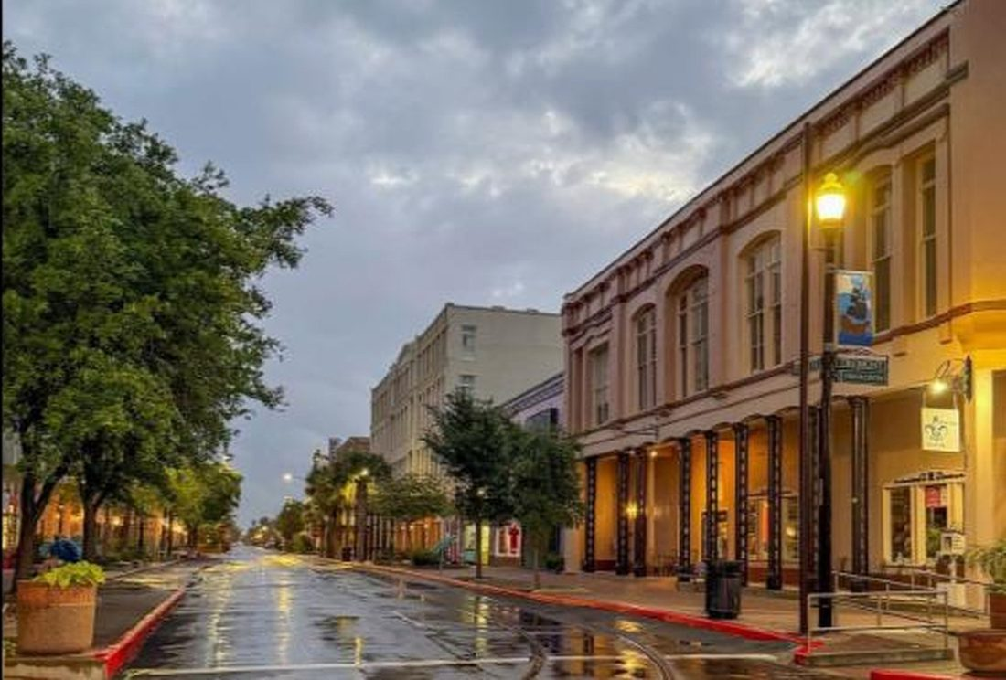
LEG ONE
The money.
Where a few million dollars comes from on an island where the bank will only lend half of it.
© 2026 Raymond Arce · Concept first published September 25, 2026

Slide 10
LEG ONE
Four sources, one fund.
Neighbors, in small shares
Small shares from people who live here: a hundred dollars for students, five hundred and up for everyone else. This is the part that does not exist today, and it is what makes the rest of it ours.
Investors who write bigger checks
The same accredited investors who already do these deals, in the same fund, on the same terms as everybody else.
A foundation to go first
Local foundations have already put two million dollars into Build Galveston's workforce housing fund. In Michigan a community foundation is matching every dollar residents invest. That match is what gets a fund off the ground.
A loan, like any other deal
The fund borrows too. Community money is one layer of the stack, not all of it, and that is what makes the arithmetic work.
Federal crowdfunding rules cap what a fund can raise that way at five million dollars in a year, and limit what each non-accredited person may invest based on income and net worth. See 17 C.F.R. 227.100. Build Galveston fund total as published by Build Galveston. The Michigan match is the Petoskey-Harbor Springs Area Community Foundation, up to one million dollars through the end of 2026.
© 2026 Raymond Arce · Concept first published September 25, 2026

Slide 11
LEG TWO
Tax Breaks: Stack four, and the deal closes.
Opportunity Zone 2.0
Texas nominated downtown and the East End for the new federal opportunity zones. If Treasury certifies them, the zone starts January 1, 2027, and investors who put capital gains into the fund pay less tax on them.
Nominated September 4. Not final
Federal historic credit
For a certified historic building, the federal government gives twenty percent of the rehabilitation cost back as a tax credit, claimed over five years.
Twenty percent of the rehabilitation cost
Texas historic credit
Texas adds a credit worth twenty five percent of the same costs. A small fund that owes little tax can sell it to somebody who does, which turns it into cash for the project.
Another twenty five percent, and it can be sold
The City's own tax freeze
Galveston already freezes City taxes for ten years when an owner puts at least half the building's value into a rehabilitation. We do not have to create this one. We have to use it.
Ten years, already on the books
Nomination date and the November 28 certification estimate from the Governor's office. Federal credit at 26 U.S.C. 47, state credit at Texas Tax Code Chapter 172, the freeze at the City of Galveston. Each one carries conditions. None is automatic. This is research, not tax advice.
© 2026 Raymond Arce · Concept first published September 25, 2026

Slide 12
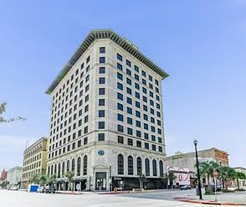
LEG THREE
The project.
A fund with no building is a bank account. Pick the building first, then raise the money against it.
© 2026 Raymond Arce · Concept first published September 25, 2026

Slide 13
LEG THREE
Building, builder, grocer, steward.
One building, named early
People do not invest in a concept. They invest in an address they drive past. Federal crowdfunding rules also shut out a fund with no specific plan.
A builder who has done this
A fund is not a builder. A Brookings researcher said it plainly at the conference here: running a fund is not the same thing as being the general partner, the one who actually builds.
A grocer who wants the space
The store is the whole point. No tenant, no groceries, and no return for the people who put money in. The tenant gets found before the money is raised, not after.
Somebody to hold the fund
A local nonprofit stewards it, with the investors at the table. Not the City, and not a candidate. I want this built, and I do not want to be anywhere near the checkbook.
© 2026 Raymond Arce · Concept first published September 25, 2026

Slide 14
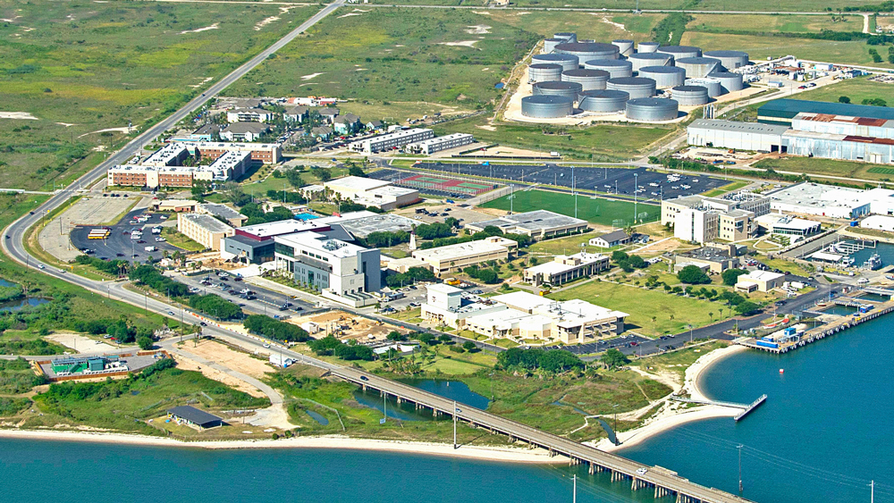
LEG FOUR
The next generation.
The college system at the table, and the first investors on this island the ones who will live with the result longest.
© 2026 Raymond Arce · Concept first published September 25, 2026

Slide 15
LEG FOUR
A hundred dollars and a lesson.
The first thing a young islander ever owns could be a piece of the block they grew up on.
The share
The training
A class for students and young islanders at one hundred dollars, built with Galveston College, UTMB and A&M Galveston. Rhode Island already prices its shares by class.
Financial literacy and investment training that comes with the share, taught through the college, the Economic Development Partnership, or a local advisor who takes it on. A sponsor can cover part of a first share.
I put this to the panel at the Neighborhood Economics conference on September 16. The answer was that it is legal and it is being done. Anyone under eighteen would hold a share through a custodial account, which is a question for the fund's lawyers.
Rhode Island share classes from the Providence Preservation Society, July 29, 2025. Custodial accounts under the Texas Uniform Transfers to Minors Act, Property Code Chapter 141.
© 2026 Raymond Arce · Concept first published September 25, 2026

Slide 16
BEFORE ANYBODY ASKS
What this is, and what it is not.
I would rather answer the hard questions on this page than in a parking lot after a meeting.
What it is not
What it is
Not the City buying a grocery store
A private fund that people here can join
Not a new tax, a new district or city money
Tax breaks that already exist, used on purpose
Not a sure thing. Investments can lose money
A building back on the tax roll with a tenant in it
Nothing on this page is an offer to invest in anything. It is a proposal for how this city could get a grocery store downtown.
When a fund like this actually opens it comes with its own lawyers, its own paperwork and its own risks, and those documents are the only place an investment decision should ever be made.
© 2026 Raymond Arce · Concept first published September 25, 2026

Slide 17
WHO HAS ALREADY DONE THIS
Three towns, and one province.
None of these is Galveston, and none of their numbers is a promise about ours.
Rhode Island
Boulder, Colorado
Petoskey, Michigan
The first fund of this kind opened in September 2024. It is raising three and a half million dollars and had about two hundred ninety thousand ten months in. Slow, and worth saying out loud.
Kachuwa, a similar community fund, has raised money since 2017. Its 310 members have invested more than twenty six million dollars, and over a hundred of them are ordinary investors.
The community foundation is matching every dollar residents put in through the end of this year, up to one million. That is the move I would ask our foundations to make.
Nova Scotia has run funds like this since 1999 with a tax credit for local investors. Forty two funds have raised over a hundred million dollars, and the businesses they backed pay about twenty five million a year in taxes.
Rhode Island figures from Local Return and the Providence Preservation Society, July 29, 2025. Kachuwa figures from the Brookings Institution, May 22, 2026. Nova Scotia figures from the 2021 CEDIF economic impact report by George Karaphillis. Petoskey match as reported July 6, 2026. Texas has no state income tax, so the Nova Scotia style credit is not a tool we have here.
© 2026 Raymond Arce · Concept first published September 25, 2026

Slide 18
THE HONEST LIMITS
Four reasons this could fail.
It raises slowly
Rhode Island took about a year to reach three hundred thousand dollars. Anybody promising this island a store by next summer is selling something.
People can lose money
This is an investment, not a savings account. If a neighbor puts in five hundred dollars, that money is at risk, and every conversation about this has to start there.
The zone is not certified yet
Downtown has been nominated, not designated. Treasury is expected to decide by the end of November. If the answer is no, one leg of the table comes off and the plan gets rebuilt.
It needs a grocer
Without an operator who wants to run a store downtown, this is a real estate deal looking for a purpose. That is the conversation I am having first.
© 2026 Raymond Arce · Concept first published September 25, 2026

Slide 19
WHY THIS STARTS WITH A HEAD COUNT
Foundations do not go first.
A foundation will match money that is already on the table. It will not put up the first dollar for an idea. So the first job is not the building or the fund. It is us.
Foundations follow demand
The count is the leverage
The arithmetic
Petoskey's foundation matched a fund residents had already joined. Build Galveston's two million came after five years of Vision Galveston asking the town what it wanted.
A list of neighbors who have said in writing they would invest is what turns a request into a negotiation. Without it we are asking for charity.
Two hundred neighbors at five hundred dollars is one hundred thousand dollars of local money. That is a number a foundation can match and a number Council cannot wave off.
Nothing on this page asks anyone for money. It asks for a show of hands, and the show of hands is the whole strategy.
Petoskey match reported July 6, 2026. Build Galveston fund as reported by The Galveston County Daily News, April 18, 2024. The two hundred by five hundred figure is an illustration, not a target that has been set.
© 2026 Raymond Arce · Concept first published September 25, 2026

Slide 20
THE ASK
First from you. Then from Council.
WHAT I AM ASKING FOR
WHAT COUNCIL CAN DO
A head count
Three things
Say whether you would put money in, and about how much. Nothing binding, nothing collected
Confirm downtown's opportunity zone the day Treasury certifies it, and say what it means
Bring five neighbors to the page, or five classmates, and tell me if you know a grocer or a building owner
Put the City's historic tax freeze in writing for a downtown grocery project
Then I take the count to the island's foundations and ask for a match
Convene Vision Galveston, Build Galveston, the GEDP and Galveston College about who holds a fund and who teaches the class
No city dollars, no city ownership, no new tax, no new district. The left column is the one that decides whether the right column ever happens.
© 2026 Raymond Arce · Concept first published September 25, 2026

Slide 21
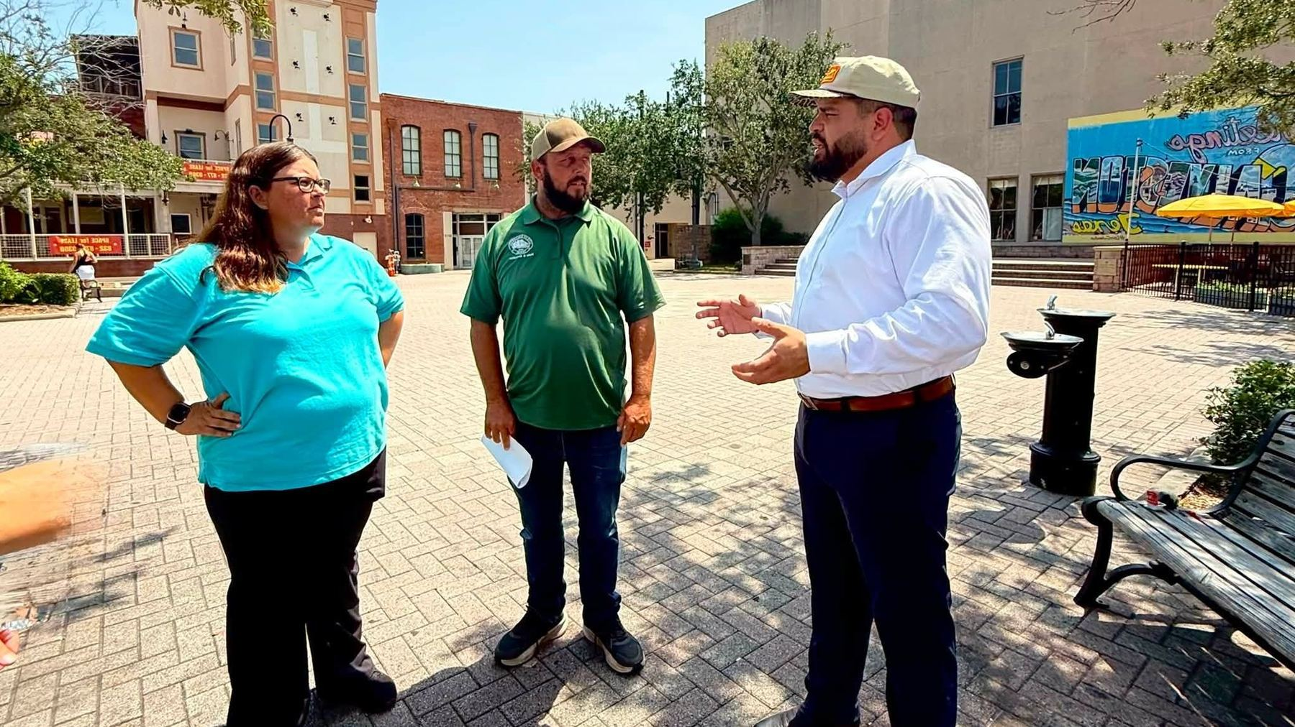
Own the block.
The money to fix downtown is already on this island. It is waiting to see how many of us show up.
Raymond Arce | Raymond4Galveston@gmail.com | raymond4galveston.com
© 2026 Raymond Arce · Concept first published September 25, 2026

