Slide 1
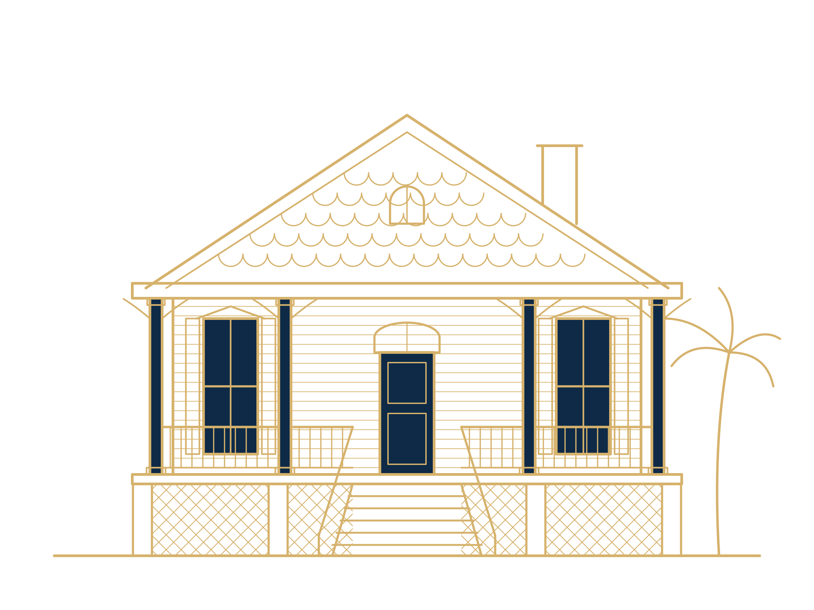
HISTORIC HOMES
Preserving Old Galveston -
how to restore what we have instead of building over it.
Two small changes to a City tax break for fixing up old homes and buildings. The City keeps every tax dollar it gets today.
Raymond Arce · Candidate, Galveston City Council, District No. 3
Notes:
Purpose: preserve Old Galveston by making restoration of historic homes affordable, so they are restored rather than built over. Two amendments to the City's Substantial Rehabilitation for Historic Properties tax exemption: every 10 percent of the building's value spent on qualifying work earns a 4-year freeze up to 50 percent (20 years), and every 10 percent after that earns 2 more years, up to 30 years at 100 percent, the same for every property; and every freeze ends when the property sells. Nothing else about the program changes. Drawing is an original illustration of an island raised cottage.

Slide 2
Substantial Rehabilitation for Historic Properties
THE RULE TODAY
1
Fix up a historic building and spend at least half of what the building is worth.
50%
2
The City then freezes your City tax at the old amount for 10 years.
of what the building is worth before work starts. The land does not count.
3
The County, the schools and the college tax the new value right away.
Source: City of Galveston. City Council adopted this program on July 23, 2015.
Notes:
Source: City of Galveston, The Financial Incentive Program, galvestontx.gov/646. Council adopted the program July 23, 2015. The owner invests at least 50 percent of the pre-improvement value of the structure; City taxes stay at the pre-improvement value for 10 years; the freeze transfers on sale. Other taxing units tax the post-improvement value. Example from the record: a 2018 verification set the threshold at $325,120 against a pre-improvement value of $650,240.

Slide 3
Half is a lot for a family
THE PROBLEM
A house where the building is worth $400,000
What the building is worth
$400,000
Work needed today
$200,000
To start under this plan
$40,000
Many families fix up their home one job at a time. Under this plan, one big job, like a new roof, can start a freeze.
Notes:
Illustration only. A building appraised at $400,000 (land not counted) needs $200,000 of qualifying work under today's 50 percent rule. Under the plan, any owner can start a 4-year freeze with $40,000 of work (10 percent). Each added 10 percent ($40,000) adds 4 years. A major roof, foundation, plumbing, wiring or heating and air job on that house could reach the 10 percent step on its own.

Slide 4
Two changes. Nothing else
THE PLAN
1. Every 10% buys a freeze
2. The freeze ends when the property sells
4 years for each 10% up to 50%. Then 2 more years for each 10%. The same rule for homes, rentals and businesses.
10%
4 years
60%
22 years
It does not go to the buyer. The owner who did the work gets the break.
20%
8 years
70%
24 years
30%
12 years
80%
26 years
40%
16 years
90%
28 years
50%
20 years
100%
30 years
The same review, the same receipts and the same Council vote as today.
Notes:
The rule: every 10 percent of the building's pre-improvement value (as set by the appraisal district, land not counted) spent on qualifying work earns a 4-year freeze on City taxes, up to 50 percent and 20 years; above 50 percent, each further 10 percent earns 2 more years, up to 100 percent and 30 years (60 percent, 22 years; 70, 24; 80, 26; 90, 28; 100, 30). The same rule applies to every eligible property: homes, rentals and businesses. Every freeze ends at a change of ownership; nothing carries over to a buyer. Ray's reasoning: at a sale the owner has had the chance to recoup the cost of the work at closing, so the City's tax break should not continue past that point. If the building is torn down or gutted, the freeze ends with no payback. Projects already approved under the 50 percent rule finish under today's rules, and freezes already granted are protected by Tax Code 11.24(b). For comparison, today's 50 percent rule earns 10 years; under this plan 50 percent earns 20 years.

Slide 5
The City keeps what it collects today
THE COST TO THE CITY
While the freeze is on, the City gets the same tax it gets now.
It only waits on tax from the new value. The owner created that value.
When the freeze ends, the City taxes the fixed-up building.
Without the incentive
Old buildings get left for someday.
With a program like this
Owners fix them up now, and our historic homes get back their original beauty.
Notes:
Ray's point for this slide: without the incentive, our buildings get left for someday; a program like this would bring a resurgence of historic homes, restored to their original beauty. Reference math if asked, using the example of a $400,000 building with $120,000 of work (30 percent, a 12-year freeze) at today's rate of $0.416273 per $100: $400,000 divided by 100, times $0.416273, is $1,665.09 a year, today's City tax. $520,000 is $2,164.62 a year, the City tax on the fixed-up building once the freeze ends. Those are yearly figures at today's values and rate, so the after-freeze figure is the same whatever the freeze length. During the freeze the City's taxable value for the building stays at the pre-improvement value, which is what it collects today. One caution for Q and A: as the City describes the freeze, the City taxes the pre-improvement value for the full term, so it also waits on ordinary market increases on that property during the freeze, not only on the restoration. The City's own reports would show how much that is.

Slide 6
Every step, from 10% to 100%
THE SAVINGS
You spend | Work on a $400,000 building | Freeze | Saved if values stay the same | Saved if values keep rising
10% | $40,000 | 4 years | $700 | $1,500
20% | $80,000 | 8 years | $2,700 | $6,200
30% | $120,000 | 12 years | $6,000 | $13,500
40% | $160,000 | 16 years | $10,700 | $23,000
50% | $200,000 | 20 years | $16,700 | $34,400
60% | $240,000 | 22 years | $22,000 | $42,500
70% | $280,000 | 24 years | $28,000 | $51,500
80% | $320,000 | 26 years | $34,600 | $61,100
90% | $360,000 | 28 years | $42,000 | $71,500
100% | $400,000 | 30 years | $50,000 | $82,600
City tax only. These are estimates for one example building. Rising values: about 10% a year, with the City lowering its rate to match. Sources are in the speaker notes.
Notes:
How to read this: every 10 percent of the building's value spent on approved work buys 4 years of frozen City taxable value up to 50 percent (20 years); each further 10 percent buys 2 more years, up to 100 percent and 30 years. Example building worth $400,000 before work (land not counted); the work is assumed to add its cost in value. City rate $0.416273 per $100, the no-new-revenue rate Council adopted for the 2026 tax year (FY2027 budget). Column 4, values stay the same: added value times today's rate times the years (for example, $120,000 divided by 100, times $0.416273, times 12 years). Column 5, values keep rising: values rise 10 percent a year and the City rate falls by a factor of 1.10 each year, the way a no-new-revenue rate (Tax Code 26.04) responds to 10 percent value growth. Each year's saving is the tax on the fixed-up building minus the tax on the frozen value. Exact figures (values same / values rising): 10 percent, 4 years: $666 / $1,520; 20 percent, 8 years: $2,664 / $6,213; 30 percent, 12 years: $5,994 / $13,495; 40 percent, 16 years: $10,657 / $22,968; 50 percent, 20 years: $16,651 / $34,359; 60 percent, 22 years: $21,979 / $42,545; 70 percent, 24 years: $27,974 / $51,479; 80 percent, 26 years: $34,634 / $61,147; 90 percent, 28 years: $41,960 / $71,537; 100 percent, 30 years: $49,953 / $82,639. Shown on the slide rounded to the nearest $100. The rising-values column assumes 10 percent growth for the whole freeze; over 20 to 30 years that is a long projection and the real result could be far lower. Why 10 percent: Texas Comptroller of Public Accounts, School District Property Value Study, Galveston ISD (084-902), category A single-family residences, local tax roll value: 2018 $6,419,053,695; 2019 $6,854,108,216; 2020 $7,439,970,313; 2021 $9,102,507,982; 2022 $10,712,573,764; 2023 $13,163,240,534; 2024 $14,384,287,492 (final studies); 2025 $13,704,155,744 (preliminary). Average yearly growth 2018 to 2025 is 11.4 percent. Tax Code 23.23 caps a homestead's appraised value increase at 10 percent a year, so 10 percent is used. Limits: Galveston ISD covers more than the City (Jamaica Beach, the west end and Bolivar Peninsula), and the totals include new construction, so existing homes grew somewhat less. Cross-check: the Galveston County Daily News reported countywide certified appraised value rising from $25.8 billion to $34.1 billion from 2016 to 2020 (reported as 31.8 percent; those figures compute to 32.2 percent), about 7.2 percent a year; Galveston ISD single-family grew 7.7 percent a year over 2018 to 2020. The City's taxable value dipped this year, from about $11.3 billion to about $11.2 billion. Assumes the freeze holds City taxable value at the pre-work amount, which the Historic Preservation Officer should confirm. The larger savings are also the tax the City waits on. At today's rate, the City still collects what it collects today; see the next slide's notes for the falling-rate case. Past growth does not promise future growth. The freeze ends early if the property sells.

Slide 7
The more you restore, the more you save
THE SAVINGS
$50,000 - $82,600
City tax saved over 30 years, with $400,000 of work.
The low end is if values stay the same. The high end is if they keep rising like they have since 2018, and the City lowers its tax rate to match.
City tax saved over the whole freeze, in thousands of dollars. Example: a building worth $400,000. Estimates; see the speaker notes.
Notes:
Same figures as the table on the previous slide, unrounded and shown in thousands (for example, $66.6k is $66,604). Brass bars: values stay the same, so the saving is the added value times today's City rate times the years. Navy bars: values rise 10 percent a year and the City lowers its rate to match, so the saving is larger. Both assume the owner keeps the property for the whole freeze; the freeze ends if the property sells. Under the rising-values case, the frozen value is taxed at a falling rate, so the owner's City bill on the frozen value also falls (about $584 in the last year of a 12-year freeze, about $105 in the last year of a 30-year freeze, versus about $1,665 today). In that case the City collects less from the property than it does today, not the same; that holds only if the City keeps today's rate.

Slide 8
The work pays the island right away
THE BIGGER RETURN
$120,000
Day one
of work on one $400,000 home goes to local contractors, workers and suppliers. Materials bought here also pay sales tax.
The schools, the County and the college tax the new value starting the first year. Only the City waits.
Notes:
Background for Q and A (the $4 to $5 figure was taken off the slide at Ray's direction): THC, Economic Impact of Historic Preservation in Texas, Update 2015 (executive summary), says every dollar from federal and state incentive programs triggers $4 to $5 of private-sector investment. The same study puts historic rehabilitation spending in Texas at about $772 million in 2013, supporting 15,398 jobs, and finds heritage travelers spent about $175 a day against $145 for other travelers. The $120,000 is the example project from earlier slides, $120,000 of work (30 percent, a 12-year freeze) on a $400,000 building. Sales tax: materials a contractor buys on the island are taxable where purchased. The other taxing units are not part of the City's freeze, so they tax the post-improvement value immediately.

Slide 9
Our neighbors to the northwest have a similar plan
ALREADY DONE IN TEXAS
Austin already lowered its bar.
Homes spend 25% of what the building is worth. Rentals and businesses spend 40%.
Their break lasts 7 years for homes and 10 years for rentals and businesses.
 | Austin | Our plan
Homes spend | 25% | 10%
Others spend | 40% | 10%
How long | 7 or 10 years | 4 to 30 years
Source: City of Austin.
Notes:
Source: City of Austin, Tax abatement for historic districts (austintexas.gov/node/53147) and Resources for Older and Historic Properties (austintexas.gov/page/incentives-and-grants). Minimum spending is measured against the pre-rehabilitation structure value set by the Travis Central Appraisal District; at least 5 percent must go to exterior work. Homesteads: 7 years, once every 10 years. Income-producing: 10 years, once every 15 years. Austin's landmark exemption separately treats owner-occupied and income-producing property differently (100 percent versus 50 percent of structure value). How ours differs: one 10 percent bar and one rule for every property; 4 years per 10 percent spent up to 50 percent, then 2 years per 10 percent, up to 30 years; ours is a freeze under Tax Code 11.24, while Austin's is an abatement; and ours ends when the property sells.

Slide 10
The laws that allow it
THE AUTHORITY
Texas Constitution, art. VIII, §1-f | Lets cities give tax breaks to save historic buildings.
Tax Code ch. 11, §11.24(a) | Lets a city cut taxes on a historic building. It sets no minimum amount of work.
Tax Code §11.24(b) | Once you have the tax break, the City can't take it away without your OK or 5 years' notice.
City of Galveston | The 2015 City program. This is the only rule that changes.
Notes:
Tex. Const. art. VIII, sec. 1-f (added Nov. 8, 1977): the Legislature may authorize political subdivisions to grant exemptions or other relief from ad valorem taxes on appropriate property so designated by the political subdivision in the manner prescribed by general law. Tax Code 11.24(a)(2): exemption of part or all of the assessed value of a structure designated as historically significant and in need of tax relief to encourage its preservation under an ordinance adopted by the governing body. 11.24(b): no repeal or reduction for a qualifying property without owner consent or five years' written notice. For the City Attorney: Tex. Const. art. VIII, sec. 1(a) says taxation shall be equal and uniform; the plan applies one rule to every eligible property. Confirm that a freeze of up to 30 years, and ending a freeze at a sale, fit Tax Code 11.24 as drafted. City program: confirm the 2015 ordinance number with the City Secretary before this is presented.

Slide 11
Two changes, one vote
WHAT COUNCIL WOULD DO
1
Every 10% of the building's value buys 4 years, up to 50%. After that, each 10% buys 2 more, up to 30 years.
2
Every freeze ends when the property sells.
Cost to the City: nothing it collects today.
Before the vote: the Landmark Commission, the City Attorney and City staff review it.
raymond4galveston.com · Raymond4Galveston@gmail.com · (409) 308-0021
Notes:
The amendments replace the single 50 percent threshold and 10-year term with one rule for every property: each 10 percent of the building's value earns 4 years up to 50 percent (20 years), then 2 years for each further 10 percent, up to 30 years at 100 percent. They also end every freeze at a change of ownership. Process, review, verification and Council approval stay as adopted in 2015. Freezes already granted under today's rules are protected by Tax Code 11.24(b) and keep today's terms. The Landmark Commission certifies and verifies these projects, so its recommendation should come first. If any part of the program sits in the Land Development Regulations, Planning Commission review and notice would also apply; confirm where the program is codified with the Historic Preservation Officer.

Slide 12
Your questions, answered
QUESTIONS AND ANSWERS
Does the City lose money?
No. While the freeze is on, the City gets the same tax it gets today. It waits on tax from the new value. When the freeze ends, it taxes the fixed-up building.
Which buildings can use it?
Buildings in a local historic district, and Galveston Landmarks. In a district, the building must be listed as Contributing or Compatible.
Will my taxes go up to cover it?
No. The fixed-up building keeps paying what it pays now. Nothing is shifted to anyone else.
What work counts?
Work that helps the building last: roof, foundation, siding, wiring, plumbing, heating and air, and the structure. Inside work can count when it comes with structural work.
Does this lower my school or County taxes?
No. The freeze covers City tax only. The schools, the County and the college tax the new value right away.
Does my own labor count?
Yes. Work you do yourself can count toward the total.
Notes:
Sources: City of Galveston, The Financial Incentive Program (galvestontx.gov/646), and the City's Tax Eligibility form, Rev. 10/2024. Eligibility: local historic district or Galveston Landmark; Contributing or Compatible; Intrusion buildings are not eligible. Sweat equity counts toward the threshold under the existing program. City-only freeze: the other taxing units are not part of the City's exemption.

Slide 13
Your questions, answered
QUESTIONS AND ANSWERS
How do I apply?
Call the City's Historic Preservation Office at (409) 797-3660. The Landmark Commission approves your plan. When you finish, you show your receipts. Then City Council gives the final OK.
What if I sell?
The freeze ends when the property sells. It does not go to the buyer.
Can I start work before I apply?
No. Get your plan approved first. The program checks the plan before any work begins.
Why does the freeze end when I sell?
When you sell, you get the chance to earn back the cost of the work. So the City's tax break ends there.
My project is already approved. Can I switch?
No. The new rules apply to projects approved after Council adopts them. Projects already approved finish under today's rules.
What is the longest freeze?
30 years, if you spend as much as the building is worth. It still ends if you sell.
Notes:
Process today: Historic Preservation Officer review of the scope, Landmark Commission certification before work, Landmark Commission verification after completion, City Council final approval. Transition and sale answers are Ray's decisions of 10/17/2026. Sale: every freeze ends at a change of ownership; nothing carries over to a buyer. Ray's reasoning: at a sale the owner has had the chance to recoup the cost of the work at closing. Longest freeze: 100 percent of the building's pre-improvement value earns 30 years (4 years per 10 percent up to 50 percent, then 2 years per 10 percent).

Slide 14
Your questions, answered
QUESTIONS AND ANSWERS
What if the building is torn down or gutted?
The freeze ends. The owner does not pay back the tax that was frozen.
Have a question we missed?
Ask me. I will answer it and add it here.
Raymond4Galveston@gmail.com
(409) 308-0021
raymond4galveston.com
Is this legal?
Yes. The Texas Constitution and the Tax Code let cities do this. The City Attorney would check the final wording.
Notes:
Teardown answer is Ray's decision of 10/17/2026: the freeze ends with no payback. Tax Code 11.24(b) bars repeal or reduction only for a property that continues to qualify, so we read an ordinance that makes continued ownership and the building's survival conditions of the exemption as consistent with 11.24(b); the City Attorney should confirm. Legal: Tex. Const. art. VIII, sec. 1-f; Tax Code 11.24(a) and (b); Tex. Const. art. VIII, sec. 1(a) equal and uniform.

