Slide 1

A PROPOSAL FOR THE EAST END
Rapid Response
Galveston already flies one aircraft, funded for catalytic converter theft. Rapid response needs its own: an upgraded aircraft, docked at a secure location on the East End, that reaches the whole east end and the water around it. What we do not have yet is that aircraft, a funded answer for what it costs to keep flying, or the policy that keeps this a response tool instead of a surveillance argument.
Three things to fix, and a way to pay for all three
Raymond Arce | Candidate, Galveston City Council District 3 | Raymond4Galveston@gmail.com
© 2026 Raymond Arce · Concept first published September 5, 2025 · This version October 2, 2026
Notes:
Open by saying what this is. The city already flies one drone, and its grant ties it to catalytic converter theft. This is a proposal for a rapid response aircraft of its own: where it launches from, who pays to keep it flying, and what rules it runs under.

Slide 2
COMMUNITY BENEFIT AND PORT SECURITY
For the neighborhoods and the port.
Residents are not asking us to solve crime. They are asking why nobody gets there in time. The channel and the terminals need the same answer on the water.
Community benefit
Port security
Shots at night that nobody can place, and street racing that moves a block ahead of the patrol car. Callers on both give up on us.
Cruise terminals, cargo piers and the ship channel. An aircraft overhead can search for a swimmer, check a vessel or spot a drone that does not belong.
Both are problems of arrival time and of eyes, not of manpower alone. The same program that marks where shots came from can be over the channel in minutes, under the same written rules. When minutes matter and a faster response costs this little, it belongs on the table.
© 2026 Raymond Arce · Concept first published September 5, 2025 · This version October 2, 2026
Notes:
Say plainly that this does not replace officers and you are not pretending it does. It buys the thing patrol cannot buy at any staffing level, which is being there in the first minute. On the water, keep to response and detection. The Coast Guard and the Port Police lead port security; this program adds eyes over it, it does not take over the mission.

Slide 3
DEFENSE AND THREAT MITIGATION
Near the port, every minute counts.
Downtown and the East End
These blocks sit beside the cruise terminals and the ship channel. A threat to the port is a threat on their street.
Next door to the port
First on scene
In a 2026 study of a California police drone program, the drone arrived in about two minutes on average. It beat patrol units to the scene on 73 percent of calls.
About two minutes
On the water
In a beach trial, a drone dropped a life buoy 100 meters offshore in a median of 30 seconds. A rescue swimmer took 65 seconds.
Twice as fast to a swimmer
Against a hostile drone
With detection and interceptors ready before the attack, Israel and its partners stopped about 99 percent of more than 300 drones and missiles in April 2024.
About 99 percent stopped
Sources: American Journal of Criminal Justice, 2026, a descriptive study of one California agency's drone program, October 2025 to January 2026; Backman and others, Air Medical Journal, 2018; Israeli military figures as reported by PBS NewsHour, April 2024. Results elsewhere are a guide, not a promise.
© 2026 Raymond Arce · Concept first published September 5, 2025 · This version October 2, 2026
Notes:
Downtown and the East End carry the port's exposure because they sit next to it. Present the numbers as what similar programs have measured, not as a promise. If the conflicts abroad come up, the record is there: with almost no navy, Ukraine used sea drones and coastal missiles to destroy about a third of Russia's Black Sea Fleet (U.S. Naval Institute Proceedings, September 2025); since March 2026, drones, drone boats, missiles and mines have struck dozens of merchant ships in the Strait of Hormuz (Lloyd's List Intelligence). The lesson in every case is the same: the side with detection in place before the attack is the side that stopped it. Keep to the technology and do not characterize any side.

Slide 4
WHERE WE ALREADY ARE
The city has bought this already.
The Department already flies one aircraft. Its grant ties it to catalytic converter theft, so this program needs its own.
$150,000
$25,000
60 seconds
State grant from the Motor Vehicle Crime Prevention Authority for a Flock Aerodome system
The city's cash match, which is the twenty percent the program requires
What the Chief told council the aircraft can put over a scene
So the argument is no longer whether Galveston should fly. It is whether a drone funded for one crime is the whole answer for 911 and the port.
Purchase request and the sixty second figure as reported by The Galveston County Daily News, grant and match figures from its roundup of the state grant program. Note that $25,000 is not twenty percent of $150,000, so confirm the award amount, the match, whether council approved it, and the aircraft's home base with the Department before presenting this.
© 2026 Raymond Arce · Concept first published September 5, 2025 · This version October 2, 2026
Notes:
Be careful and be accurate here. Say these figures come from the paper and that you have asked the Department to confirm them. Nothing kills a proposal faster than a number the Chief has to correct in the room.

Slide 5
WHERE WE ALREADY ARE
Our drone is funded for one crime.
It is funded for catalytic converter theft
It came from the state catalytic converter theft grant. State law says that money is "to be used only for" catalytic converter theft. Any other 911 call needs the grant office's approval and city money.
It cannot reach the east end
Three miles from 54th Street stops around 14th Street. UTMB, Stewart Beach, Fish Village, the ferry landing, Beachtown and Bolivar Roads are outside it.
It cannot be in two places
One aircraft and one dock. When it is on a call, charging, grounded by weather or down for maintenance, nothing else is in the air.
It cannot stop a hostile drone
It is a camera, not a countermeasure. Detecting or disabling a drone takes approved equipment and FBI-certified officers under federal law.
City of Galveston grant no. 608-26-0840400C, "GPD Catalytic Converter Theft Reduction Program," $533,212 (MVCPA FY2026 grant listing). Transportation Code section 1006.153(e); MVCPA Grant Administrative Manual section 3.3.2.1 on changes in use. Range is the three-mile working assumption. Counter-drone authority: 6 U.S.C. 124n.
© 2026 Raymond Arce · Concept first published September 5, 2025 · This version October 2, 2026
Notes:
Lead with the first row; it is the limit that matters most. The drone came from the City's FY2026 catalytic converter grant, and Transportation Code section 1006.153(e) says that money is to be used only for activities to detect and prevent catalytic converter theft. That does not ground the aircraft. It can fly other calls, but grant money cannot pay for them, and making it a general 911 aircraft is a change in use that needs the grant office's written approval first, under section 3.3.2.1 of its grant manual. Say this without criticizing the purchase. The aircraft is a real asset; the point is that the program we are proposing has to be paid for with money meant for it.

Slide 6
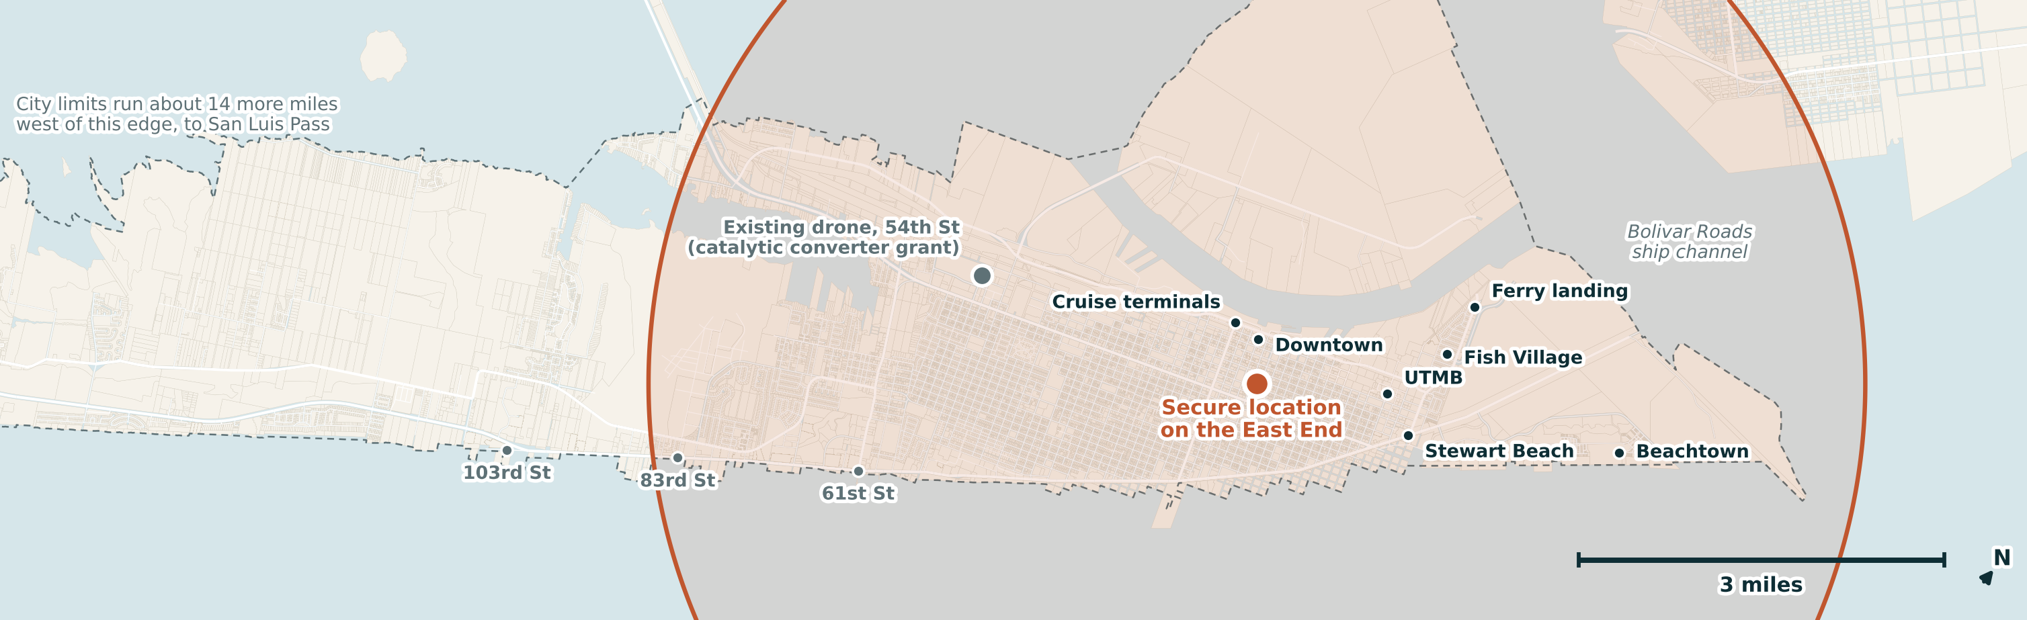
WHAT EACH LAUNCH POINT BUYS
Drawn to scale from parcel maps.
The new aircraft is an upgraded five-mile model. From either location it reaches downtown, the cruise terminals, UTMB, Stewart Beach, Fish Village, the ferry landing, Beachtown, the channel and Bolivar Roads.
From the East End location it reaches about 62 percent of the city's property parcels, west to about 86th Street. From the Pelican Island location it reaches about 57 percent, west to about 70th Street.
Galveston Central Appraisal District parcel, street and city limit data, April 14, 2026. The new aircraft is drawn at five miles, a range to confirm with the vendor, the Department and the FAA. The existing drone at 54th Street is shown for location only; it is funded for catalytic converter theft. Either location needs the owner's agreement.
© 2026 Raymond Arce · Concept first published September 5, 2025 · This version October 2, 2026
Notes:
The red map is the proposal: an upgraded five-mile aircraft docked at a secure location on the East End. The yellow map is the same aircraft at the alternate, a secure location on Pelican Island, if the first site is not available. The gray dot is the drone the city already flies. It is shown for location only, because its grant ties it to catalytic converter theft, and this program does not lean on it. From the East End location the new aircraft reaches about 62 percent of the city's property parcels, the whole east end, the channel and Bolivar Roads. From Pelican Island it reaches about 57 percent. Be straight that the far west end is outside either circle, and say so before somebody from the west end says it for you. Ask the Chief to correct the range rather than arguing it. On the west end, do not propose an address in the room. Say the candidates are the ones the city already owns, the airport, a fire station, and the Moody Gardens area, and that staff should price them.

Slide 7
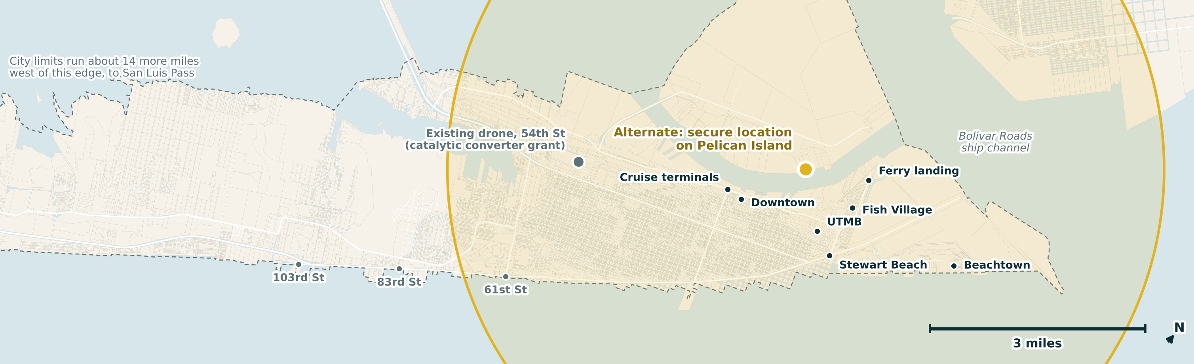
WHAT EACH LAUNCH POINT BUYS
Drawn to scale from parcel maps.
The new aircraft is an upgraded five-mile model. From either location it reaches downtown, the cruise terminals, UTMB, Stewart Beach, Fish Village, the ferry landing, Beachtown, the channel and Bolivar Roads.
From the East End location it reaches about 62 percent of the city's property parcels, west to about 86th Street. From the Pelican Island location it reaches about 57 percent, west to about 70th Street.
Galveston Central Appraisal District parcel, street and city limit data, April 14, 2026. The new aircraft is drawn at five miles, a range to confirm with the vendor, the Department and the FAA. The existing drone at 54th Street is shown for location only; it is funded for catalytic converter theft. Either location needs the owner's agreement.
© 2026 Raymond Arce · Concept first published September 5, 2025 · This version October 2, 2026
Notes:
The red map is the proposal: an upgraded five-mile aircraft docked at a secure location on the East End. The yellow map is the same aircraft at the alternate, a secure location on Pelican Island, if the first site is not available. The gray dot is the drone the city already flies. It is shown for location only, because its grant ties it to catalytic converter theft, and this program does not lean on it. From the East End location the new aircraft reaches about 62 percent of the city's property parcels, the whole east end, the channel and Bolivar Roads. From Pelican Island it reaches about 57 percent. Be straight that the far west end is outside either circle, and say so before somebody from the west end says it for you. Ask the Chief to correct the range rather than arguing it. On the west end, do not propose an address in the room. Say the candidates are the ones the city already owns, the airport, a fire station, and the Moody Gardens area, and that staff should price them.

Slide 8
WHAT WOULD MAKE IT A PROGRAM
An idea is like a table.
Every table needs at least three legs to stand on. An aircraft is not a program. These three things have to be true at once, and each one pays for a weakness in the others.
1
2
3
Its own launch point
A funded second year
Rules in writing, first
An upgraded five-mile aircraft at a secure location on the East End, with a secure location on Pelican Island as the alternate, funded and flown for this program and not borrowed from another.
The grant buys hardware. Pilots, batteries, software and the replacement airframe come out of the general fund. Price that through year six before we order anything.
A published use and retention policy and a public report, adopted before the new aircraft flies rather than after somebody sues.
Fund one and you have a gadget. Fund all three and you have something that survives a budget cycle and a public hearing.
© 2026 Raymond Arce · Concept first published September 5, 2025 · This version October 2, 2026
Notes:
The third leg is the one people skip and it is the one that decides whether the first two survive. Say that out loud.

Slide 9
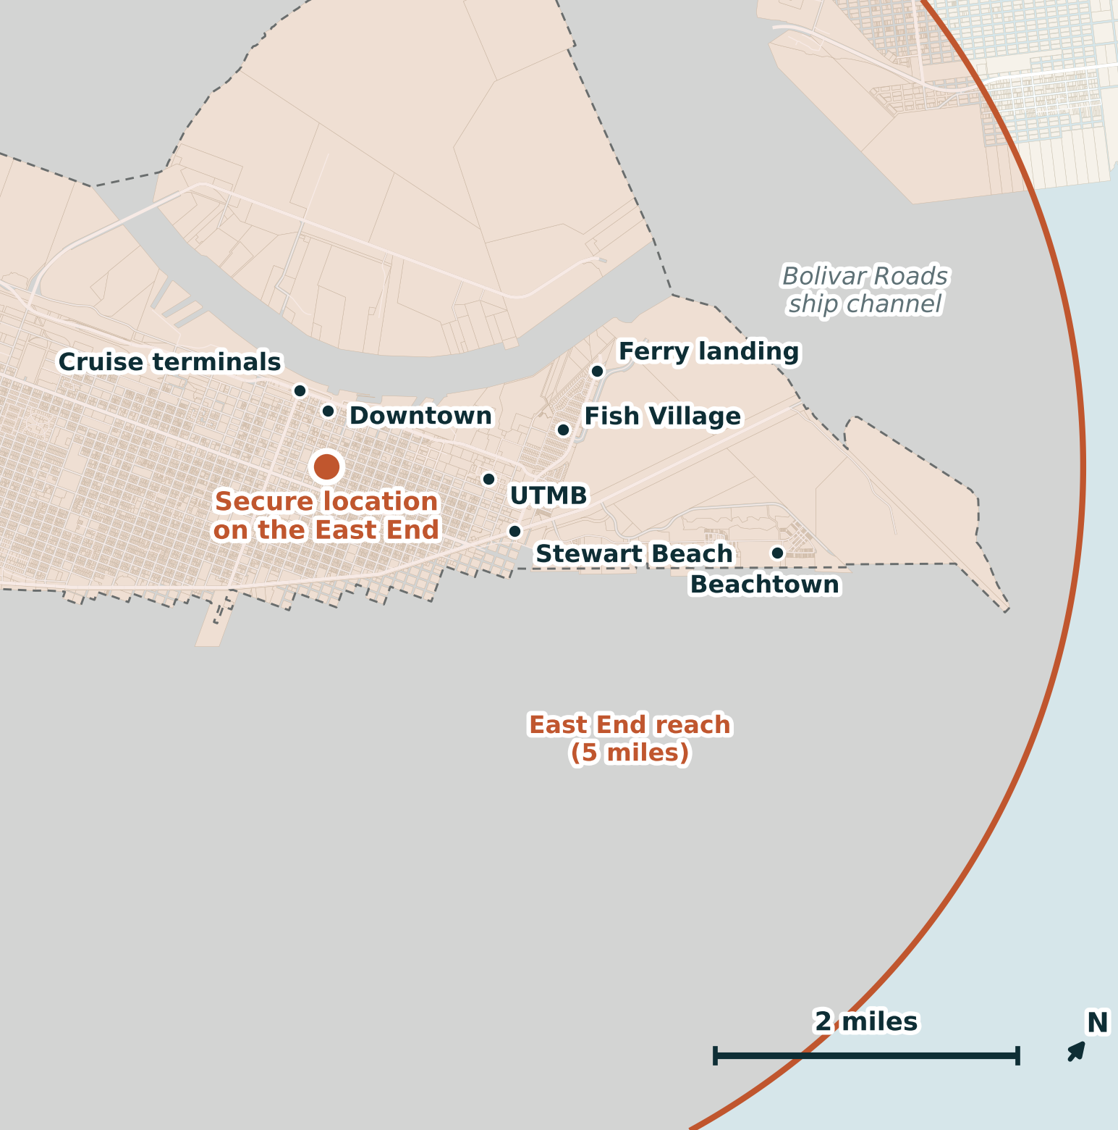
LEG ONE
Where it launches from.
The drone at 54th Street is funded for catalytic converter theft. This program needs its own: an upgraded five-mile aircraft at a secure location on the East End, or at the alternate, a secure location on Pelican Island, covering the whole east end and the water around it.
© 2026 Raymond Arce · Concept first published September 5, 2025 · This version October 2, 2026
Notes:
Pause here. The slide after this pair is the only one that asks for a piece of hardware, so let the room see the shape of the ask before the detail. The red and yellow versions are the same proposal from two possible roofs.

Slide 10
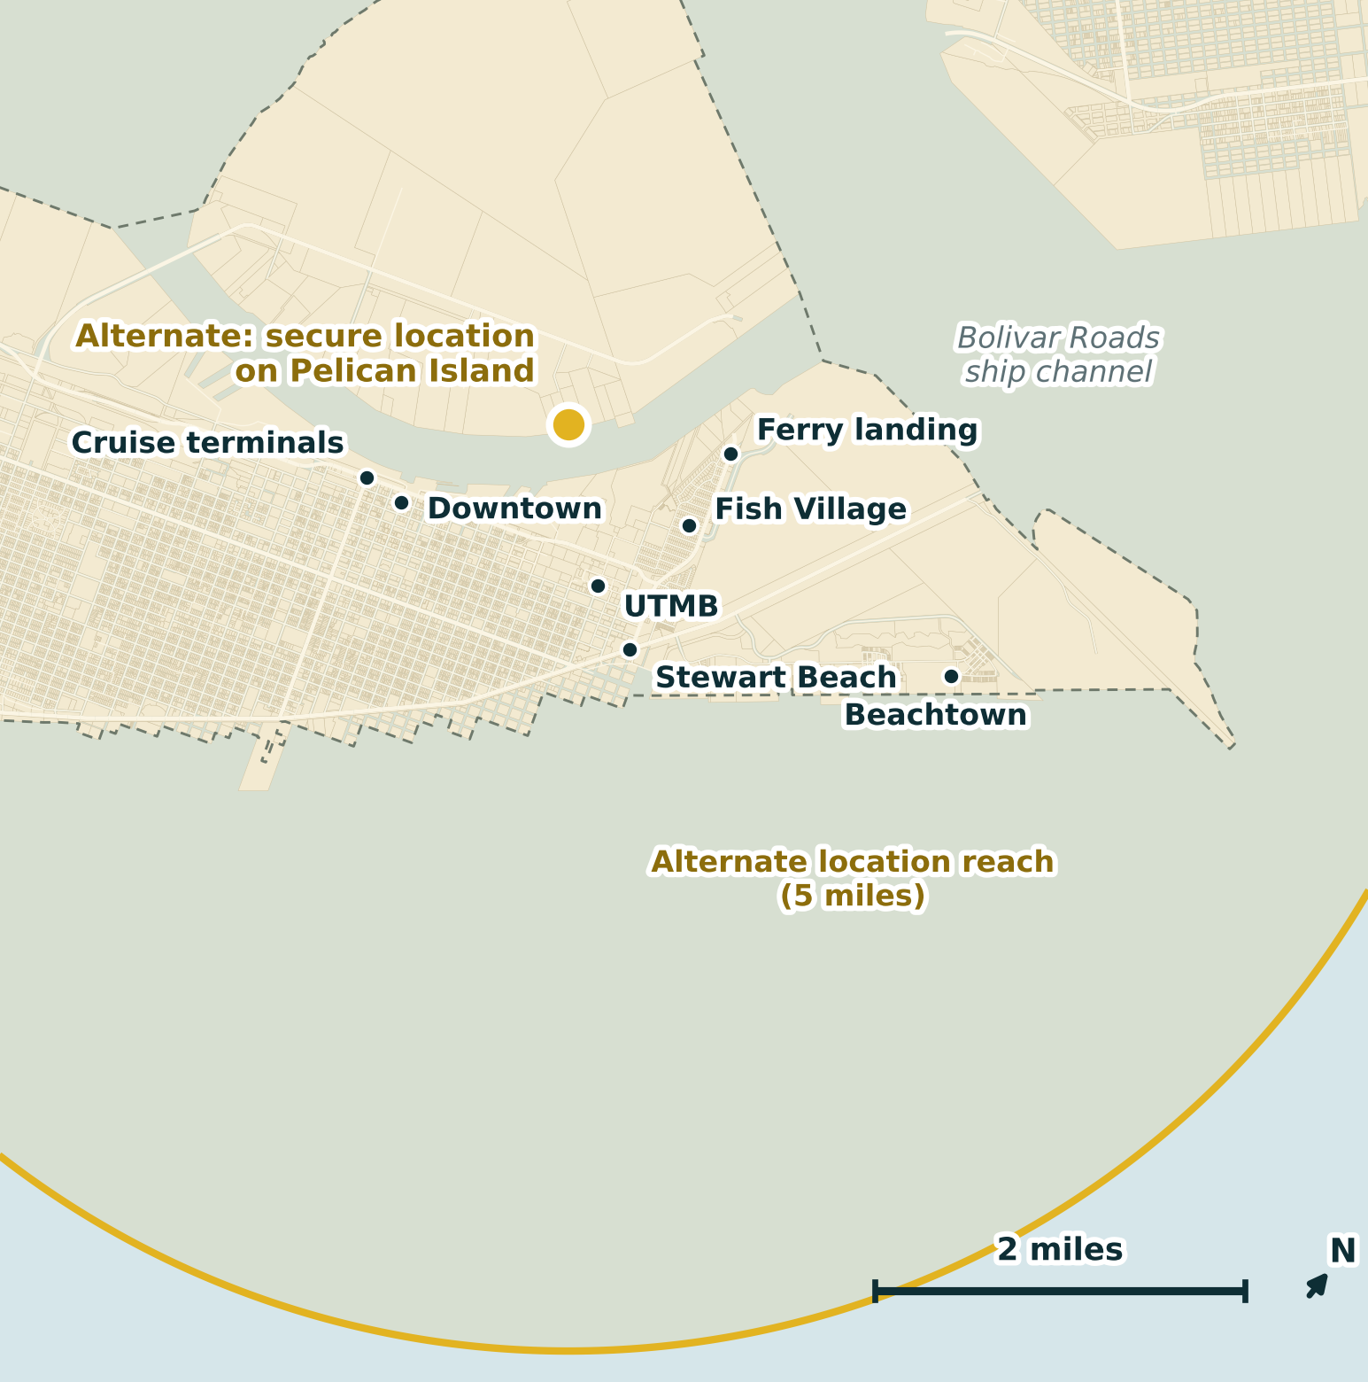
LEG ONE
Where it launches from.
The drone at 54th Street is funded for catalytic converter theft. This program needs its own: an upgraded five-mile aircraft at a secure location on the East End, or at the alternate, a secure location on Pelican Island, covering the whole east end and the water around it.
© 2026 Raymond Arce · Concept first published September 5, 2025 · This version October 2, 2026
Notes:
Pause here. The slide after this pair is the only one that asks for a piece of hardware, so let the room see the shape of the ask before the detail. The red and yellow versions are the same proposal from two possible roofs.

Slide 11
LEG ONE
A launch point of its own.
It is a rooftop, not a building
A docked aircraft needs a secure roof, power and connectivity. The first site to price is a secure location on the East End. A secure location on Pelican Island is the alternate.
It covers the east end and the water
From either location, five miles takes in downtown, the cruise terminals, UTMB, Stewart Beach, Fish Village, the ferry landing, Beachtown, the channel and Bolivar Roads.
It is its own program
The existing drone is funded for catalytic converter theft. This aircraft is funded and flown for 911 response and threats on the water, under its own written rules.
It is the cheap half of the program
The aircraft and the dock are the one time cost. What recurs is software, training and pilots, and that is the part leg two is about.
© 2026 Raymond Arce · Concept first published September 5, 2025 · This version October 2, 2026
Notes:
If somebody asks why the East End: it puts downtown and the port well inside a launch point instead of near the edge of one. If that site does not work, the alternate is a secure location on Pelican Island, on the channel. The exact sites are not named in public materials.

Slide 12

LEG TWO
What it costs to keep it flying.
The grant is the easy part. The bill that arrives every year after is the one that decides whether this program survives.
© 2026 Raymond Arce · Concept first published September 5, 2025 · This version October 2, 2026
Notes:
This is the slide that separates a proposal from a wish. Slow down going into it.

Slide 13
LEG TWO
The grant buys it. The city keeps it.
Most grants buy equipment for a year or two. Pilots, batteries, licenses and the airframe that wears out in year four fall to the city.
What grants cover
What they do not promise
The aircraft, the dock, detection equipment and training, within each grant's period and match.
Pilot hours, batteries, connectivity and software renewals year after year, and the replacement cycle.
What that runs elsewhere
So we name our number first
Schenectady, a city of 69,471, pays $694,994 over six years for a single launch point.
Price years two through six, publish it, and adopt it before the new aircraft is ordered.
This is the leg that decides whether we are still flying in year four.
Schenectady contract amount, term and council date as reported by The Daily Gazette. Grant terms vary by program and cycle; see the money slide.
© 2026 Raymond Arce · Concept first published September 5, 2025 · This version October 2, 2026
Notes:
Be ready for the partnership question. Chapter 791 of the Government Code is the tool for an interlocal agreement among the City, the County and the Port. From the County, we may only be seeking two things: help with funding, and a secure home for the dock on the East End. The Police Department flies it either way. Keep one line firm. The written rules, not the partnership, decide who can see the footage. That is the question that made people uneasy about the cameras, and one department flying the aircraft keeps the answer short. Then make the affirmative case: the honest risk with grant funded equipment is that the grant buys it and the city inherits it, and we are proposing to price that before we buy rather than after.

Slide 14
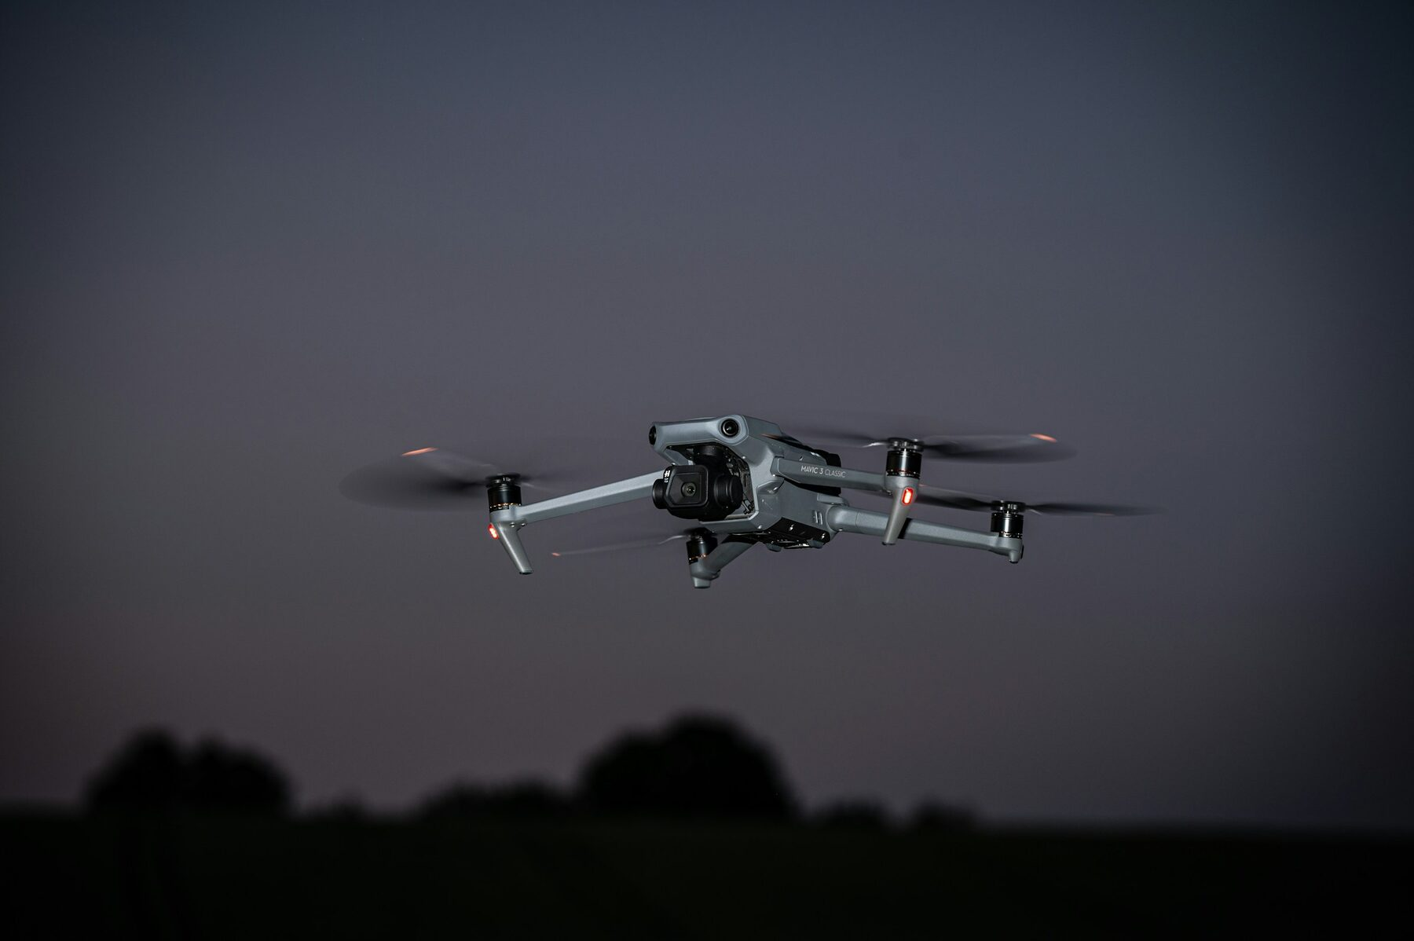
LEG THREE
The rules, in writing, first.
Adopted before the new aircraft flies, not after somebody has to sue to find out what they were.
© 2026 Raymond Arce · Concept first published September 5, 2025 · This version October 2, 2026
Notes:
Lead into this one by saying it is the leg people skip and the one that decides whether the other two survive a public hearing.

Slide 15
LEG THREE
Write the rules before it flies.
Launch on a call, not on a hunch
A retention clock in writing
The aircraft goes up because a call came in. No patrol patterns, no orbiting a neighborhood, no flights looking for something to find.
Footage that is not evidence gets deleted on a stated schedule, and the schedule is published rather than left to the vendor's default.
Say who else can see it
Report it the way big cities must
Name every agency and every vendor the data touches. The Police Department flies it, so the list starts with one department.
Every flight, why it launched, what it assisted, what it swept up incidentally, and what it cost. Published, not filed.
None of this is exotic. The last card is the report the Legislature already requires of police in cities and counties over 150,000. We would adopt it by choice in a city of about 53,000 because it is the right way to run the thing.
© 2026 Raymond Arce · Concept first published September 5, 2025 · This version October 2, 2026
Notes:
This is the slide that separates you from the Flock fight. You are not arguing that the concerns are silly. You are proposing to answer them in writing before anyone has to file a request to find out.

Slide 16
HOW FAR I WOULD GO
Publish the flight log, not the video.
Two cities already let anyone open this without filing a request. Both are worth copying. One thing is not.
Lewisville, Texas
Chula Vista
What we do not copy
A public dashboard that updates on a short delay while flights are up. Map pins are randomized on purpose, so it never publishes the caller's address.
Every flight afterward: date, time, case number, block address, call type and the path on a map, archived back years.
Live video to the public. It broadcasts a stranger's worst afternoon and it is one bad link away from something worse.
The vendors already collect this data. Publishing it is a policy decision, not a purchase.
Dashboards operated by the Lewisville Police Department and the Chula Vista Police Department. On the third card: in June 2026 researchers found five San Francisco Police drone feeds, color and thermal, on the open internet behind a passwordless sharing link for six months, with thousands of GPS coordinates and the pilots' names, as reported by DroneXL.
© 2026 Raymond Arce · Concept first published September 5, 2025 · This version October 2, 2026
Notes:
This is the slide that wins over the people who came to the meeting worried. You are volunteering more transparency than the law requires, and you are naming the one thing you will not do and why. Do not skip the San Francisco example. It is what makes the restraint credible instead of stingy.

Slide 17
WHAT STATE LAW SAYS
The state's report, filed by choice.
Government Code Chapter 423
Optional is the opportunity
Section 423.008 has police post a public report on every drone flight, every two years
It costs nothing to adopt
The statute already lists what goes in: when, where, why, what it helped with and what it cost.
It applies only to police in cities and counties over 150,000 people. Ours is about 53,000
It is the answer to the objection
So for our Police Department the report is optional. Senate Bill 2569 put it online in 2025
The strongest answer to a worry about surveillance is a report anyone can read.
It is ready for the next change
Section 423.007 leaves drone rules to DPS. Our written rules are our own proposal
The Legislature changed this report in 2025. A program built to the full standard now does not get rebuilt when it changes again.
Government Code sections 423.007 and 423.008; Senate Bill 2569, 89th Legislature, signed June 20, 2025; DPS rule at 37 Texas Administrative Code section 1.143. This is research and not legal advice, and the City Attorney should confirm the current text.
© 2026 Raymond Arce · Concept first published September 5, 2025 · This version October 2, 2026
Notes:
Read the list in section 423.008 out loud if the room is skeptical. It is exactly what people worry nobody is tracking, and the state already makes big cities track it. Be precise about what the law does not do. Section 423.007 has DPS write the rules for police drones, and the DPS rule asks only for FAA compliance and this report. No state law makes a city our size write its own drone policy or file the report. Both are offered by choice. If asked about the County: the cutoff counts the county's population for a county agency, and Galveston County is over 150,000, so the report would be required if the Sheriff flew the aircraft. Under this proposal the Police Department flies it, so for us it stays a choice.

Slide 18
WHAT FEDERAL LAW NOW ALLOWS
Local police can now stop drones.
SAFER SKIES Act
What it means on the water
Codified at 6 U.S.C. 124n, it opened counter-drone authority to local police on July 1, 2026
Detection is the first step
Sensors that watch for drones over the terminals and the channel need only the online certification. They watch aircraft, not people.
Detect, track and warn: officers certify through an online FBI course
Stopping one takes certified officers
Disable or seize a drone: in-person FBI training, an approved system and notice to the FAA
Only trained agency officers may disable a drone, and contractors may not. That staffing belongs in the leg two budget.
It fits money already on the table
Mitigations are reported to DOJ and DHS within 48 hours. Authority ends December 31, 2031.
The FEMA counter-drone grant pays for detection and mitigation, and ports, cities and counties can apply under the state.
SAFER SKIES Act, Pub. L. 119-60, div. H, title LXXXVI, codified at 6 U.S.C. 124n; DOJ and DHS interim final rule, Federal Register Doc. 2026-13609, July 6, 2026, effective July 1, 2026. Grant terms as summarized by the National League of Cities. This is research and not legal advice.
© 2026 Raymond Arce · Concept first published September 5, 2025 · This version October 2, 2026
Notes:
Until July 1, a local officer could not lawfully jam or take down a drone; federal criminal law reserved that to a few federal agencies. Now a certified local officer can, under the federal rule, with an approved system and a report to DOJ and DHS within 48 hours. Detection comes first and needs only the online certification. Say plainly that detection watches the sky for aircraft, not the street for people, and that it runs under the same written rules as leg three. The City Attorney should confirm the current rule before any equipment is bought.

Slide 19
THE OBJECTION WE WILL GET
This town is already having this fight.
The camera contracts drew an ACLU of Texas objection, a Daily News editorial asking council to slow down, and a non binding ballot question up the road in League City. Pretending otherwise is how you lose the room.
A camera watches a place
This answers a call
It is always on and nobody called it
It launches because a person dialed 911
It collects everyone who passes, all day
It goes to one address and comes home
The argument is about what it keeps and who it is shared with
It can be logged flight by flight, which a fixed camera cannot
That distinction only holds if we write it down and hold ourselves to it. That is leg three, and it is why leg three is not optional.
The Daily News editorial board asked council to defer the vote and let residents see the proposal first. That is a process argument, and it is one we can meet.
© 2026 Raymond Arce · Concept first published September 5, 2025 · This version October 2, 2026
Notes:
Do not attack the ACLU or the paper. Agree with the principle and out-specific them. The editorial asked for public vetting before a vote, which is exactly what you are offering to build into the program.

Slide 20
TIMING
The FAA has to say yes first.
It flies miles to a call, past where the pilot can see. That takes FAA permission.
TODAY
IN FRONT OF US
AFTER THAT
Case by case
Part 108
Phased in
Police may fly beyond the pilot's sight only with FAA permission granted to that agency. It takes months to get.
One standing FAA rule for these flights. Proposed in August 2025, and in final White House review since July 10, 2026.
The final rule will set its own start dates. Departments that already hold FAA permission will be ready first.
Do not wait for the rule. FAA permission and the interlocal agreement both take months, so both should start now.
Part 108 proposed rule, 90 Federal Register 38212, August 7, 2025; under White House review since July 10, 2026, and not published as of late September 2026. Today agencies fly beyond sight under an FAA certificate of authorization or a public safety waiver.
© 2026 Raymond Arce · Concept first published September 5, 2025 · This version October 2, 2026
Notes:
Ask the Department first whether it already holds FAA permission to fly beyond the pilot's sight. If it does, this slide gets shorter, and the new aircraft may be able to build on it. If it does not, the request goes in now, because it takes months and the rule may not publish until the end of the year.

Slide 21
WHAT THE FAA CHECKS
Height is not the only FAA rule.
Height is not sight
A drone must stay under 400 feet and in its pilot's sight. They are separate rules. A flight miles out to a call breaks the sight rule at any height.
Low is how the waiver works
The FAA's public safety waiver allows flights beyond sight at or below 200 feet, close to buildings and trees. Up to 400 feet takes approved gear that detects other aircraft.
The airport's airspace
Scholes airport's controlled airspace reaches 4.1 miles out, 6 a.m. to 6 p.m. It covers about 60 percent of the parcels the new aircraft reaches, from about 31st Street west. Flights there need FAA approval.
Crowds and darkness
Flying over crowds at the terminals or Stewart Beach needs an approved aircraft type, prop guards or a parachute, except to save a life. Night flights are allowed with lighting and training.
14 CFR 107.29, 107.31, 107.39, 107.41 and 107.51; FAA public safety Part 91 BVLOS waiver checklists, 200-foot and detect-and-avoid, 2025; Galveston Class D, Federal Register Doc. 05-23847, December 9, 2005; tower hours per FAA airport data. Overlap computed from appraisal district parcels.
© 2026 Raymond Arce · Concept first published September 5, 2025 · This version October 2, 2026
Notes:
This is the answer when somebody says the drone will just stay low. Height and sight are two different rules, and the sight rule is the one rapid response has to clear. The FAA's public safety waiver for police and fire comes in two forms: one keeps flights at or below 200 feet and close to buildings and trees, the other allows up to 400 feet with approved detect-and-avoid equipment. Most departments use the 200-foot version. The airport point surprises people. Scholes' Class D airspace is a 4.1-mile circle that applies while the tower is open, 6 a.m. to 6 p.m., and it takes in about three in five of the parcels the new aircraft would reach from either roof, roughly 31st Street west. The waiver includes airspace approval up to the FAA's facility map heights near the airport; anything higher needs a separate approval. Over people, the life-safety exception covers an emergency, not routine flights over a crowd. Ask the Department which path it already uses, Part 107 with waivers or a public aircraft certificate, because that decides which of these applies.

Slide 22
A PROCUREMENT TRAP WORTH NAMING
Buy an aircraft the grant can pay for.
Federal money has a list
The American Security Drone Act bars federal funds from buying covered foreign unmanned aircraft. A grant that pays for the wrong airframe is a grant that gets clawed back.
The supply side already moved
The review Congress set for the largest foreign manufacturer was not completed by its December 2025 deadline, and the consequence was a new equipment authorization freeze rather than a flight ban.
Austin tried this in Texas
House Bill 41 in the 89th session would have restricted governmental entities from acquiring covered foreign equipment. It did not reach the floor. It will be back.
So buy for the worst case
An airframe that satisfies the federal list keeps every funding door open and cannot be grounded by the next session. Anything else is a bet on a legislature.
This is research, not a legal opinion or a procurement recommendation. Purchasing under Local Government Code Chapter 252 still applies and the City Attorney and Purchasing should verify the current federal list before any award.
© 2026 Raymond Arce · Concept first published September 5, 2025 · This version October 2, 2026
Notes:
This is the slide that makes staff take you seriously. It is a question nobody in the room will have asked yet, and it is the one that decides whether the grant money is safe.

Slide 23
WHERE THE MONEY IS
Next in line, and coming back around.
FEMA Counter-UAS Grant Program
Pays to detect, track and stop hostile drones, with no local match. It runs through the Governor's office, and the FY2027 notice is expected but not yet posted.
Next round: $250 million
FEMA Port Security Grant Program
The Port applies, with a 25 percent match. Drones and drone detection are allowed. The FY2026 round closed July 24, 2026, and the program returns every year.
Next round expected mid-2027
Closed or closing before we can act, and back every cycle
DOJ Byrne JAG, local award. Due October 9, 2026, before our next meeting. About $35,000 to the City and the County, with no match, and drones are now allowed with prior federal approval.
FEMA Homeland Security Grant Program, Houston area. Closed July 24, 2026. Galveston County is inside the Houston urban area; projects need a terrorism-prevention link.
DOJ COPS Community Policing Development microgrants. Closed August 24, 2026. Up to $200,000 with no match, and the 2026 notice named drones.
BJA FY2026 JAG Local solicitation; FEMA C-UAS, Port Security and Homeland Security grant notices; COPS FY2026 microgrant notice. Dates and amounts change each cycle and should be checked against the current notice.
© 2026 Raymond Arce · Concept first published September 5, 2025 · This version October 2, 2026
Notes:
Lead with the counter-drone money. It is the large door, it runs through the Governor's office, and the next round has not posted, so the work now is being ready when it does. The port security grant is the Port's to file, with a 25 percent match, and its next round is expected around mid-2027. The box at the bottom is the point about timing: these programs closed this summer or close before our next meeting, and they come back every year. The JAG award is due October 9, ahead of the October 11 meeting, so it is a next-cycle item. If asked about the state grant that bought the first aircraft: Transportation Code section 1006.154 limits it to motor vehicle crime, so it is not the vehicle for this expansion.

Slide 24
THE ASK
Four things, none of them a purchase.
WHAT I AM ASKING FOR
WHAT I AM NOT ASKING FOR
A first step
No money tonight
Seek an interlocal agreement among the City, the County and the Port
No purchase, no contract and no budget amendment
Ask whether the County would help fund the program and help find a secure home for the dock on the East End
No new authority over anybody's data
Price the five-mile aircraft and its running cost through year six
Nothing that cannot be undone at the next meeting
Adopt written flight rules and the state's public flight report, by choice
The last item is the one to lead with. It costs nothing, it answers the loudest objection in the room, and it is the reason the others get a hearing.
© 2026 Raymond Arce · Concept first published September 5, 2025 · This version October 2, 2026
Notes:
Close by naming the sequence. Policy first, cost second, hardware last. That order is what makes this a governing proposal instead of a shopping list. On the interlocal, ask rather than presume. From the County, we may only be seeking help with funding and a secure home for the dock on the East End. The Police Department flies it either way. The Port is invited under Chapter 791 of the Government Code on whatever terms suit it. Whatever shape the agreement takes, the written rules decide who can see the footage.

Slide 25
WHERE THIS LEAVES US
The money exists. Here is the work.
WHAT IS AVAILABLE
WHAT WE HAVE TO OVERCOME
Money and authority
The work before the money
FEMA counter-drone money, about $250 million, opening next
An interlocal agreement, a roof, and the County's help with funding
Port security grant, next round expected mid-2027
A use policy that ties every flight to a lawful use under Chapter 423
Homeland security and federal JAG grants, back every year
An aircraft on the federal approved list, and FAA approval to fly beyond sight
State law already lists port security as a lawful drone use
Certified officers for any drone takedown, and a local share of the cost
None of it is out of reach. All of it moves faster when the City, the County and the Port work from the same calendar.
© 2026 Raymond Arce · Concept first published September 5, 2025 · This version October 2, 2026
Notes:
Leave this one on screen for questions. The left side is what exists today; the right side is the work that turns it into an aircraft over the channel. Anchor it if asked: port security is a listed lawful use under Government Code section 423.002(a)(18); drone takedowns rest on 6 U.S.C. 124n and require FBI-certified officers; the interlocal runs under Government Code chapter 791; and federal money buys only aircraft on the approved list. The port security grant carries a 25 percent local match.

Slide 26

We live on an island.
There are only so many ways off it. That is a strategic advantage and we are not using it.
Raymond Arce | Raymond4Galveston@gmail.com | raymond4galveston.com
© 2026 Raymond Arce · Concept first published September 5, 2025 · This version October 2, 2026
Notes:
Response, not surveillance. Say it one more time on the way out, because it is the sentence people will repeat for you when you are not in the room.

